Slide 1
Python programming application
Anara Karymsakova
E-mail: hatae@mail.ru
This document has been produced with the support of the EUROPEAN COMMISSION under the ERASMUS+ Programme,
KA2 – Capacity Building in the Field of Higher Education: 598092-EPP-1-2018-1-BG-EPPKA2-CBHE-SP.
It reflects the views only of the authors, and the Commission cannot be held responsible for any use which may be made of the information contained therein.

Slide 2
Problem - solving focus
Notes:
Python programming: An Introduction to Computer Science

Slide 3
Python is an interpreted, object-oriented, high-level programming language with dynamic semantics.
Notes:
Python is a high-levelgeneral-purpose programming languagewith anemphasisondeveloperproductivityand codereadabilityPython and the vast majority of its libraries arefree and come in source codes. Moreover, unlike many open systems, the licensedoes not restrict the use of Python incommercial development in any wayPython has a clear syntax. Itminimizes such auxiliary constructions asbrackets,word-organizers of blocks.In return,the programmer must strictly observe the margins,which are the organizers of the blocks. Inas a result, the code turns out to be unloaded with unnecessaryelements and easy to read.

Slide 4
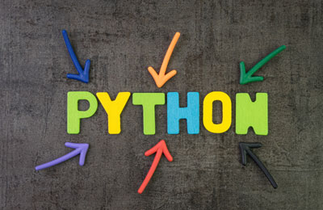
Advantages of Python
Speed;
Additional modules;
Libraries;
Modernity;
Popularity
Notes:
The speed of execution of programs written in Python is very high. This is due tothe fact that the main Python libraries are written in C++ and taskstake less time to complete than in other high-level languages.In this regard, you can write your own modules for Python in C orC++In standard Python libraries you can find tools for working withe-mail, Internet protocols, FTP, HTTP, databases, etc.Scripts written using Python are executed on mostmodern operating systems. This portability provides Python application in the mostvarious fields.Python is suitable for any programming solutions, be itoffice programs, web applications, GUI applications, etc.Thousands of enthusiasts from all over the world worked on the development of Python. We can be indebted for the support of modern technologies in standard librariesprecisely to the fact that Python was open to everyone.

Slide 5
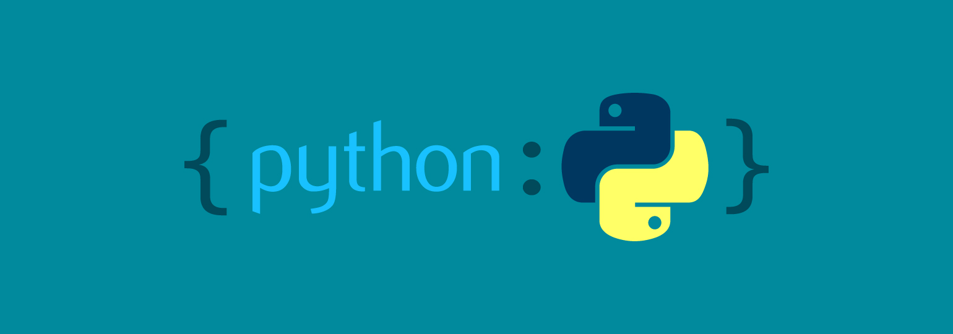
Disadvantages of Python
Low speed;
Inefficient memory consumption;
Weak in mobile devices;
Difficult to access database;
Prone to cause runtime errors
Notes:
Disadvantages of PYTHON
PYTHON, like other interpretedlanguages, has a relatively lowprogram execution speed. However,
in thecase of Python, this disadvantage iscompensated by a decreasein the development time of the program. On average, aPython program is 2-4 times more compactthan its C++ or Java counterpart.Dynamic typing raisesquestions for methodologists inprogramming training

Slide 6
Syntax
Notes:
First of all, it is worth noting an interesting feature of Python.It does not contain operator brackets (begin..end in pascalor {..}in C), instead, blocks are indented:spaces or tabs, and the input to the block of operators iscarried out by a colon. Single-line commentsbegin with the pound sign "#", multi-linecomments begin and end with three double quotes""""".To assign a value to a variable, the sign"=" is used, and for comparison - "==". To increase the value ofa variable, or add to a string, usethe operator is "+=", and for reduction - "-=". All these operationscan interact with most types,including strings.

Slide 7
Python contains data structures such as lists, tuples, and dictionaries.
Notes:
Data structures
Python contains data structures such as lists, tuples, and dictionaries. Lists are similar to one-dimensional arrays (but you can use a List that includes lists — a multidimensional array), tuples are immutable lists, dictionaries are also lists, but indexes can be of any type, not just numeric. "Arrays" in Python can contain data of any type, that is, numeric, string and other data types can be in one array. Arrays start at index 0, and the last element can be obtained at index -1. You can assign functions to variables and use them accordingly.

Slide 8
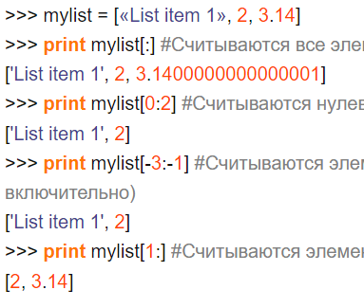
You can use part of the array by specifying the first and last index separated by a colon ":"
Notes:
You can use part of the array by specifying the first and last index separated by a colon ":". In this case, you will get a part of the array, from the first index to the second, not inclusive. If the first element is not specified, then the count starts from the beginning of the array, and if the last one is not specified, then the array is read to the last element. Negative values determine the position of the element from the end.

Slide 9
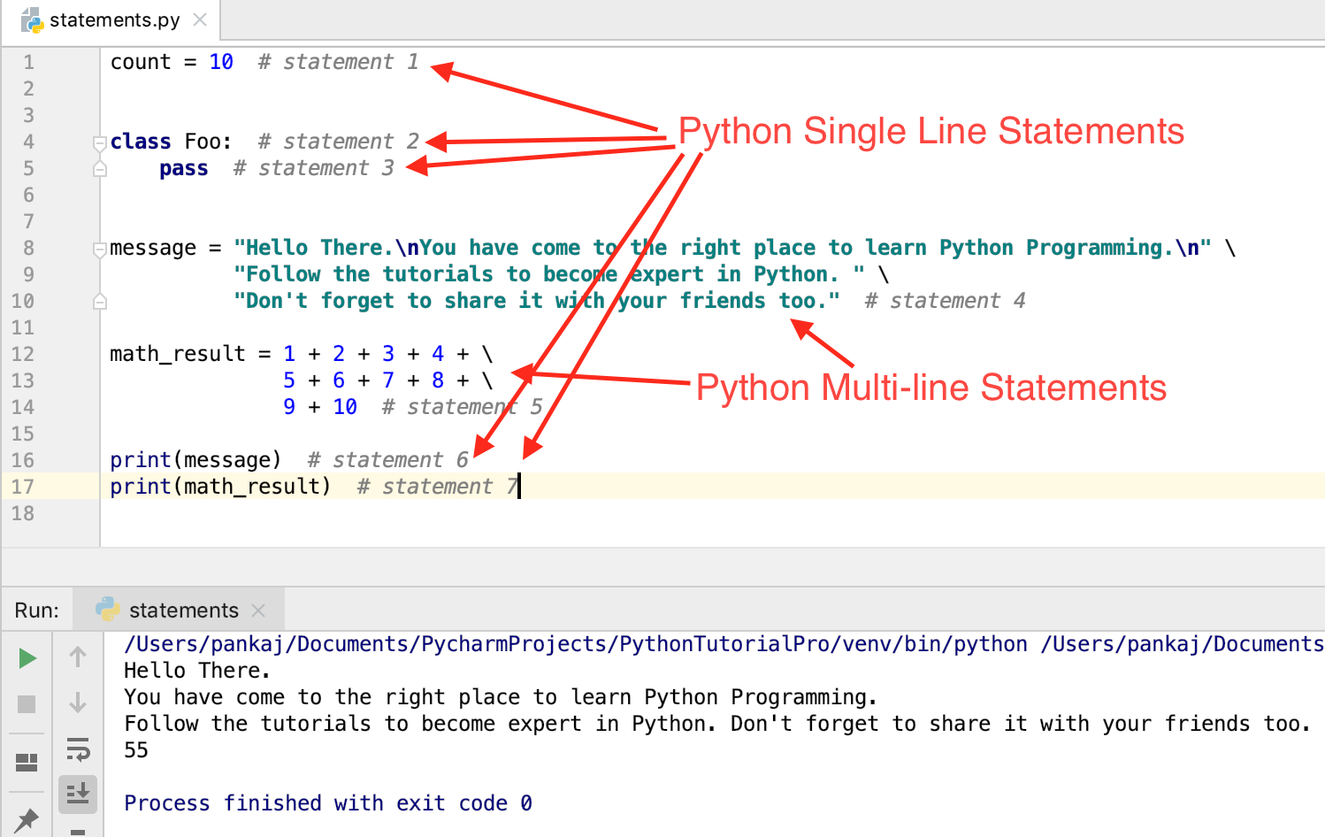
Lines
Notes:
Python strings are separated by double """ or single "'" quotes. There may be single quotes inside double quotes or vice versa. For example, the line "He said 'hello'!" will be displayed as "He said 'hello'!". If you need to use a string of several lines, then this line should begin and end with three double quotes """"". You can substitute elements from a tuple or dictionary into a string template. The percentage sign "%" between the string and the tuple, replaces the characters "%s" in the string with the tuple element. Dictionaries allow you to insert an element under a given index into a string. To do this, use the construction "%(index)s" in the string. In this case, instead of "%(index)s", the dictionary value under the specified index will be substituted.

Slide 10
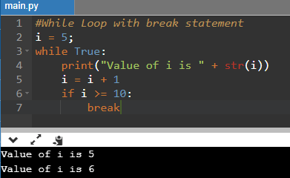
Operators
The while, if, and for operators make up the move operators.
Notes:
Operators
The while, if, and for operators make up the move operators. There is no analogue of the select operator here, so you will have to do if. In the for statement, a variable and a list are compared. To get a list of digits up to the number <number> — use the range(<number>) function. Here is an example of using operators

Slide 11
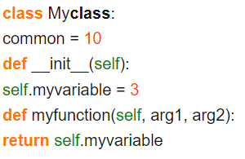
Classes
Here we have declared the Myclass class. The __init__ function is called automatically when classes are initialized.
Notes:
Classes
Python is limited in multiple inheritance in classes. Internal variables and internal methods of classes start with two underscores "__" (for example, "__myprivatevar"). We can also assign a value to a class variable from the outside. Example:

Slide 12
Syntax features:
The comment starts with the "#" character.
To split long logical strings into physical ones (to increase readability), a slash \ or ordinary brackets () are used.String literals are enclosed in quotation marks.
Moreover, they can be any - single or double.
The main thing is that the selected pair belongs to the same type.
Notes:
Writing commentsReadable code must contain comments, no matter how the developers treat them. The presence of comments makes the code more readable for your colleagues, and therefore in Python, as in any YAP, this function is implemented.Syntax features:The comment starts with the "#" character.To split long logical strings into physical ones (to increase readability), a slash \ or ordinary brackets () are used.String literals are enclosed in quotation marks. Moreover, they can be any - single or double. The main thing is that the selected pair belongs to the same type.

Slide 13
References
https://ppt-online.org/706077
https://techrocks.ru/2019/01/21/about-python-briefly/
https://wtmatter.com/python-while-loops/

Slide 14
Спасибо за внимание!
Дополнительную консультацию можно получить в ФИТ, ауд. 212 или Skype
This document has been produced with the support of the EUROPEAN COMMISSION under the ERASMUS+ Programme,
KA2 – Capacity Building in the Field of Higher Education: 598092-EPP-1-2018-1-BG-EPPKA2-CBHE-SP.
It reflects the views only of the authors, and the Commission cannot be held responsible for any use which may be made of the information contained therein.

