Slide 1
Teaching methods. Innovative approaches to teaching
Compiled by: Karymsakova A.E.

Slide 2
Any human education is nothing but the art of assisting nature's striving for its own development.
I. Pestalozzi

Slide 3
Teaching methods are ways of joint activity of a teacher and students aimed at solving learning problems.
Yu.K. Babanskiy

Slide 4
"Method" in Greek means - research, method, way to achieve the goal.
“A method is a way to achieve a goal, an activity ordered in a certain way”
Philosophical Dictionary
Reception is an integral part or a separate side of the method.

Slide 5
Classification of teaching methods
verbal methods;
visual methods;
methods of practical training;
problem learning methods.

Slide 6
Verbal Methods:
story
explanation
conversation
discussion
lecture
work with a book

Slide 8
Visual methods:
illustration method
Demo method

Slide 9
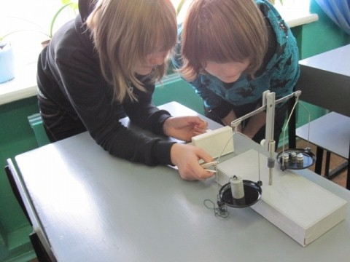
Practical teaching methods:
Exercises
creative work
Laboratory works
Practical lesson

Slide 12
Problem-Based Learning Methods
Reporting presentation with elements of problematicity
Cognitive problem statement
Dialogic problem statement
Heuristic or partial search method
research method

Slide 13
Innovative teaching methods
They have the following features:
"forced activity" of students
forced activation of thinking and activity
increasing the emotional involvement of students
creative nature of classes
obligatory direct interaction of students with each other and the teacher
the formation of collective efforts aimed at intensifying the learning process

Slide 14
Types of innovative teaching methods
Active teaching methods are teaching methods in which the student's activity is productive, creative, and exploratory in nature.
Active learning methods include: didactic games, case analysis, problem solving, learning by algorithm, brainstorming.
Intensive training methods are used to organize training in a short time with long one-time sessions ("immersion method"). These methods are used in teaching business, marketing, a foreign language, in practical psychology and pedagogy.

Slide 16
Choice of teaching methods
the general purpose of education;
feature of the subject being studied;
feature of teaching methods;
purpose, objectives and content of the material of a particular lesson;
the time allotted for the study of a particular material;
age of students;
the level of preparedness of students;
material equipment of the educational institution;
opportunities and features of the teacher.

