Slide 2
Contents
What is Unity?
Workflow
Main interface
Scripting
Rendering
Physics
Animation
2D & 3D
Multiplatform
Examples

Slide 3
Introduction
Unity is a powerful cross-platform 3D engine and a user friendly development environment. Easy enough for the beginner and powerful enough for the expert; Unity should interest anybody who wants to easily create 3D games and applications for mobile, desktop, the web, and consoles.
That’s why I want to tell you about this one of the most popular game engine.

Slide 4
What is Unity?
Unity is a cross-platform game engine with a built-in Integrated Development Environment developed by Unity Technologies. It is used to develop video games for web plugins, desktop platforms, consoles and mobile devices.
Unity 1 launched onstage at Apple’s Worldwide Developers Conference 2005 by David Helgason, Nicholas Francis, and Joachim Ante.

Slide 5
Workflow
Unity is powerful, complete game development system
Create 3D objects / scenes in Unity
Or import objects created in 3D modelling packages
Use scripting to control animations / scene changes etc.
Export to stand alone game, or web page component, or mobile app

Slide 6
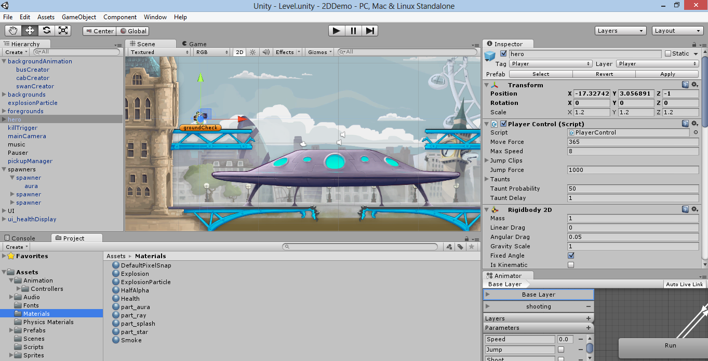
Main interface

Slide 7
Unity actually is the union of
(1) a game engine, that allows game created to run (hence to be played) in different environments,
(2) an application where the “visible pieces” of a game can be put together (the IDE) with a graphical preview and using a controlled “play it” function, and
(3) a code editor

Slide 8
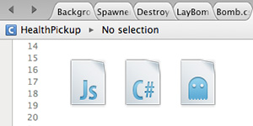
Scripting
The game engine's scripting is built on Mono, the open-source implementation of the .NET Framework. Programmers can use:
UnityScript (a custom language with syntax, referred to as JavaScript by the software)
C#
Boo (which has a Python-inspired syntax)

Slide 9
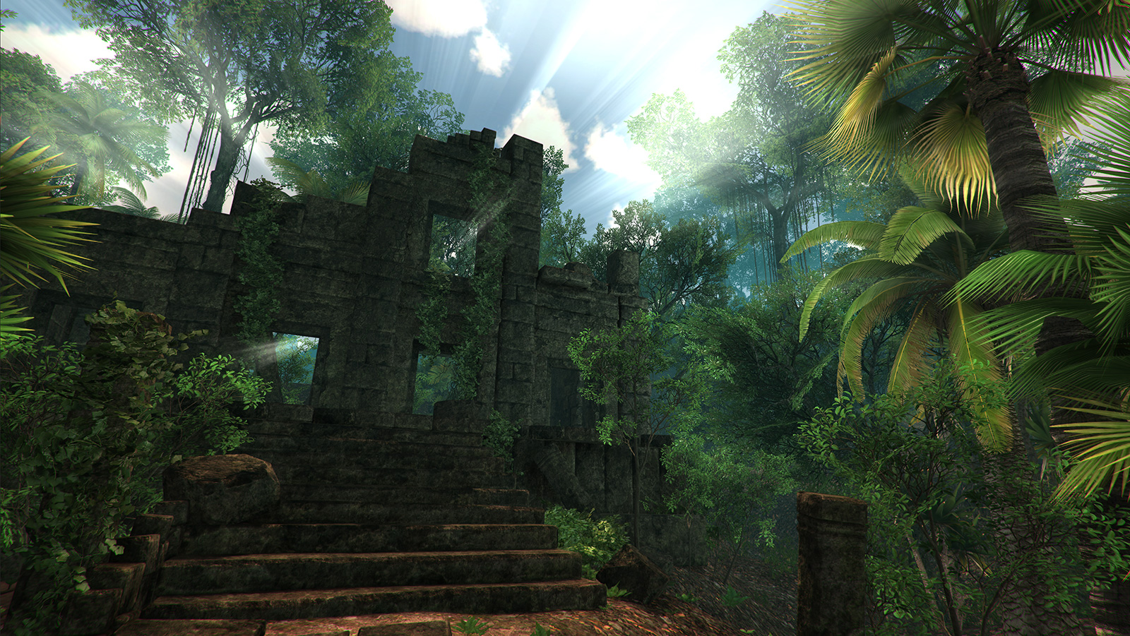
Rendering
Unity supports art assets and file formats from 3ds Max, Maya, Blender, Adobe Photoshop and other graphics programs. These assets can be added to the game project, and managed through Unity's graphical user interface.

Slide 10
2D & 3D
All scenes in Unity are 3D, with 2D games rendered using flat planes. This means it’s incredibly easy to combine 3D and 2D elements. Simply switch your Scene view between 2D and 3D and make use of Perspective and Orthographic cameras.

Slide 11
Multiplatform
Unity supports deployment to multiple platforms. Within a project, developers have control over delivery to mobile devices, web browsers, desktops, and consoles.

Slide 12
Conclusion
So once you have the game design and all the required skills you can put together graphics, sounds, animations in Unity’s IDE, write in the editor the code associated to the assets and then generate a playable application that runs in several different environments, as one of the features of Unity is that it is multi-platform, that is more or less the same game can run similarly on an iPad or on Windows. Because of these features Unity is a popular game engine in video game development.

Slide 13
References
http://wikipedia.org/wiki/Unity_(game_engine)
http://unity3d.com
http://forum.unity3d.com
http://designagame.eu

