Slide 1
Python programming application
Anara Karymsakova
E-mail: hatae@mail.ru
This document has been produced with the support of the EUROPEAN COMMISSION under the ERASMUS+ Programme,
KA2 – Capacity Building in the Field of Higher Education: 598092-EPP-1-2018-1-BG-EPPKA2-CBHE-SP.
It reflects the views only of the authors, and the Commission cannot be held responsible for any use which may be made of the information contained therein.

Slide 2
Python for data analysis

Slide 3
Data analysis
Notes:
Data analysis is defined as a process of cleaning, transforming, and modeling data to discover useful information for business decision-making. The purpose of Data Analysis is to extract useful information from data and taking the decision based upon the data analysis. Whenever we take any decision in our day-to-day life is by thinking about what happened last time or what will happen by choosing that particular decision. This is nothing but analyzing our past or future and making decisions based on it. For that, we gather memories of our past or dreams of our future. So that is nothing but data analysis. Now same thing analyst does for business purposes, is called Data Analysis.

Slide 4
Types of Data Analysis: Techniques and Methods
Statistical Analysis
Techniques and Methods
Text Analysis
Diagnostic Analysis
Predictive Analysis
Prescriptive Analysis
Descriptive Analysis
Inferential Analysis
Notes:
There are several types of Data Analysis techniques that exist based on business and technology. However, the major types of data analysis are:
Text Analysis;
Statistical Analysis;
Diagnostic Analysis;
Predictive Analysis;
Prescriptive Analysis.

Slide 5
Data Analysis Process
Data Requirement Gathering
Data Collection
Data Cleaning
Data Analysis
Data Interpretation
Data Visualization
Notes:
Data Analysis consists of the following phases:
Data Requirement Gathering;
Data Collection;
Data Cleaning;
Data Analysis;
Data Interpretation;
Data Visualization.

Slide 6
Python as a Data Analytics Tool
Python
Easy to learn
Scalable
Extensive set of libraries
Readable
Easy integration with other apps
Active community & ecosystem
Notes:
Data analysis tools make it easier for users to process and manipulate data, analyze the relationships and correlations between data sets, and it also helps to identify patterns and trends for interpretation.
The nature of Python makes it a perfect-fit for data analytics:
Easy to learn;
Readable;
Scalable;
Extensive set of libraries;
Easy integration with other apps;
Active community & ecosystem.

Slide 7
Popular Python Data Analytics Libraries
NumPy
Fundamental Scientific Computing
SciPy
Pandas
Data Manipulation and Analysis
Matplotlib
Plotting and Visualization
Scikit-learn
Machine Learning and Data Mining
StatsModels
Statistical Modeling, Testing, and Analysis
Seaborn
For Statistical Data Visualization
Notes:
Python has extensive library support for data science and analytics. There are many Python libraries that contain a host of functions, tools, and methods to manage and analyze data. Each of these libraries has a particular focus with some libraries managing image and textual data, data mining, neural networks, data visualization, and so on.
NumPy stands for Numerical Python. The most powerful feature of NumPy is n-dimensional array. This library also contains basic linear algebra functions, Fourier transforms, advanced random number capabilities and tools for integration with other low level languages like Fortran, C and C++.
SciPy stands for Scientific Python. It is built on NumPy. Scipy is one of the most useful library for variety of high level science and engineering modules like discrete Fourier transform, Linear Algebra, Optimization and Sparse matrices.
Pandas for structured data operations and manipulations. It is extensively used for data munging and preparation. Pandas were added relatively recently to Python and have been instrumental in boosting Python’s usage in data scientist community.
Matplotlib for plotting vast variety of graphs, starting from histograms to line plots to heat plots.. You can use Pylab feature in ipython notebook (ipython notebook –pylab = inline) to use these plotting features inline. If you ignore the inline option, then pylab converts ipython environment to an environment, very similar to Matlab.
Scikit-Learn for machine learning. Built on NumPy, SciPy and matplotlib, this library contains a lot of efficient tools for machine learning and statistical modeling including classification, regression, clustering and dimensional reduction.
Statsmodels for statistical modeling. It is a Python module that allows users to explore data, estimate statistical models, and perform statistical tests. An extensive list of descriptive statistics, statistical tests, plotting functions, and result statistics are available for different types of data and each estimator.
Seaborn for statistical data visualization. It is a library for making attractive and informative statistical graphics in Python. It is based on matplotlib. Seaborn aims to make visualization a central part of exploring and understanding data.

Slide 8
Loading Python Libraries
In [ ]:
#Import Python Libraries
import numpy as np
import scipy as sp
import pandas as pd
import matplotlib as mpl
import seaborn as sns
Notes:
A library is a collection of files that contains functions for use by other programs.
May also contain data values and other things. Library’s contents are supposed to be related, but there’s no way to enforce that.
The Python standard library is an extensive suite of modules that comes with Python itself.
Many additional libraries are available from the Python Package Index.

Slide 9
Reading data using pandas
In [ ]:
#Read csv file
df = pd.read_csv("http://rcs.bu.edu/examples/python/data_analysis/Salaries.csv")
There is a number of pandas commands to read other data formats:
pd.read_excel('myfile.xlsx',sheet_name='Sheet1', index_col=None, na_values=['NA'])
pd.read_stata('myfile.dta')
pd.read_sas('myfile.sas7bdat')
pd.read_hdf('myfile.h5','df')
Notes:
Pandas is the most popular data manipulation package in Python.
CSV (comma-separated value) files are a common file format for transferring and storing data. The ability to read, manipulate, and write data to and from CSV files using Python is a key skill to master for any data scientist or business analysis.
You might have your data in .csv files or SQL tables. Maybe Excel files. Or .tsv files. Or something else.
But the goal is the same in all cases. If you want to analyze that data using pandas, the first step will be to read it into a data structure that’s compatible with pandas.

Slide 10
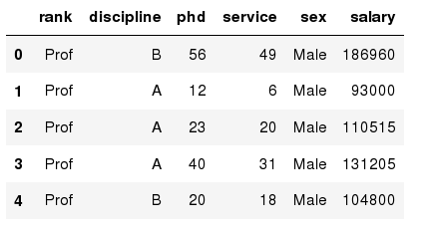
Exploring data frames
In [3]:
#List first 5 records
df.head()
Out[3]:
Notes:
The head() function is used to get the first n rows.
This function returns the first n rows for the object based on position. It is useful for quickly testing if your object has the right type of data in it.
In this example, you can see the first 5 records.

Slide 11
DataFrame data types
Pandas Type | Native Python Type | Description
object | string | The most general dtype. Will be assigned to your column if column has mixed types (numbers and strings).
int64 | int | Numeric characters. 64 refers to the memory allocated to hold this character.
float64 | float | Numeric characters with decimals. If a column contains numbers and NaNs(see below), pandas will default to float64, in case your missing value has a decimal.
datetime64, timedelta[ns] | N/A (but see the datetime module in Python’s standard library) | Values meant to hold time data. Look into these for time series experiments.
Notes:
A data type is essentially an internal construct that a programming language uses to understand how to store and manipulate data. For instance, a program needs to understand that you can add two numbers together like 5 + 10 to get 15.
A possible confusing point about pandas data types is that there is some overlap between pandas, python and numpy. This table summarizes the key points.

Slide 12
Data Frame data types
In [4]:
#Check a particular column type
df['salary'].dtype
Out[4]:
dtype('int64')
In [5]:
#Check types for all the columns
df.dtypes
Out[4]:
rank
discipline
phd
service
sex
salary
dtype: object
object
object
int64
int64
object
int64
Notes:
Pandas DataFrame is a two-dimensional size-mutable, potentially heterogeneous tabular data structure with labeled axes (rows and columns). Arithmetic operations align on both row and column labels. It can be thought of as a dict-like container for Series objects. This is the primary data structure of the Pandas.
Pandas DataFrame.dtypes attribute return the dtypes in the DataFrame. It returns a Series with the data type of each column.

Slide 13
Data Frames Attributes
Data Frames Methods
df.method() | description
head( [n] ), tail( [n] ) | first/last n rows
describe() | generate descriptive statistics (for numeric columns only)
max(), min() | return max/min values for all numeric columns
mean(), median() | return mean/median values for all numeric columns
std() | standard deviation
sample([n]) | returns a random sample of the data frame
dropna() | drop all the records with missing values
df.attribute | description
dtypes | list the types of the columns
columns | list the column names
axes | list the row labels and column names
ndim | number of dimensions
size | number of elements
shape | return a tuple representing the dimensionality
values | numpy representation of the data
Notes:
Python objects have attributes and methods.
Unlike attributes, python methods have parenthesis.
All attributes and methods can be listed with a dir() function: dir(df)

Slide 14
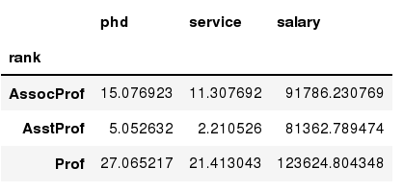
Data Frames groupby method
In [ ]:
#Group data using rank
df_rank = df.groupby(['rank'])
In [ ]:
#Calculate mean value for each numeric column per each group
df_rank.mean()
Notes:
Using "group by" method we can:
Split the data into groups based on some criteria;
Calculate statistics (or apply a function) to each group;
Similar to dplyr() function in R.

Slide 15
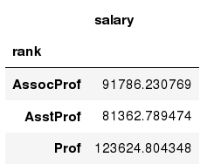
Data Frames groupby method
In [ ]:
#Calculate mean salary for each professor rank:
df.groupby('rank')[['salary']].mean()
Notes:
Once groupby object is create we can calculate various statistics for each group.

Slide 16
Data Frames groupby method
In [ ]:
#Calculate mean salary for each professor rank:
df.groupby(['rank'], sort=False)[['salary']].mean()
Notes:
groupby performance notes:
- no grouping/splitting occurs until it's needed. Creating the groupby object only verifies that you have passed a valid mapping;
- by default the group keys are sorted during the groupby operation. You may want to pass sort=False for potential speedup:

Slide 17
Data Frame: filtering
In [ ]:
#Calculate mean salary for each professor rank:
df_sub = df[ df['salary'] > 120000 ]
> greater;
< less;
== equal;
>= greater or equal;
<= less or equal;
!= not equal;
In [ ]:
#Select only those rows that contain female professors:
df_f = df[ df['sex'] == 'Female' ]
Notes:
To subset the data we can apply Boolean indexing. This indexing is commonly known as a filter. For example if we want to subset the rows in which the salary value is greater than $120K:
Any Boolean operator can be used to subset the data:
> greater;
< less;
== equal;
>= greater or equal;
<= less or equal;
!= not equal;

Slide 18
Data Frames: Slicing
In [ ]:
#Select column salary:
df['salary']
In [ ]:
#Select column salary:
df[['rank','salary']]
Notes:
There are a number of ways to subset the Data Frame:
one or more columns;
one or more rows;
a subset of rows and columns.
Rows and columns can be selected by their position or label.
When selecting one column, it is possible to use single set of brackets, but the resulting object will be a Series (not a DataFrame):
When we need to select more than one column and/or make the output to be a DataFrame, we should use double brackets:

Slide 19
Data Frames: Selecting rows
In [ ]:
#Select rows by their position:
df[10:20]
Notes:
If we need to select a range of rows, we can specify the range using colon ":"
Notice that the first row has a position 0, and the last value in the range is omitted:
So for 0:10 range the first 10 rows are returned with the positions starting with 0 and ending with 9.

Slide 20
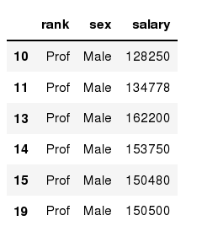
Data Frames: method loc
In [ ]:
#Select rows by their labels:
df_sub.loc[10:20,['rank','sex','salary']]
Out[ ]:
Notes:
If we need to select a range of rows, using their labels we can use method loc.

Slide 21
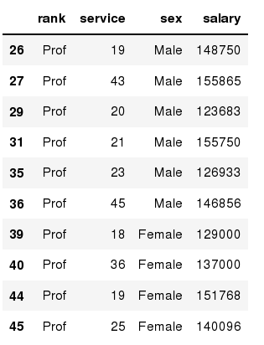
Data Frames: method iloc
In [ ]:
#Select rows by their labels:
df_sub.iloc[10:20,[0, 3, 4, 5]]
Out[ ]:
Notes:
If we need to select a range of rows and/or columns, using their positions we can use method iloc.

Slide 22
Data Frames: method iloc (summary)
df.iloc[0] # First row of a data frame
df.iloc[i] #(i+1)th row
df.iloc[-1] # Last row
df.iloc[:, 0] # First column
df.iloc[:, -1] # Last column
df.iloc[0:7] #First 7 rows
df.iloc[:, 0:2] #First 2 columns
df.iloc[1:3, 0:2] #Second through third rows and first 2 columns
df.iloc[[0,5], [1,3]] #1st and 6th rows and 2nd and 4th columns
Notes:
The iloc indexer for Pandas Dataframe is used for integer-location based indexing / selection by position.
The iloc indexer syntax is data.iloc[<row selection>, <column selection>], which is sure to be a source of confusion for R users.
“iloc” in pandas is used to select rows and columns by number, in the order that they appear in the data frame.

Slide 23
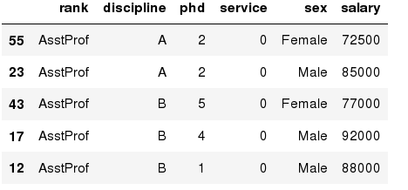
Data Frames: Sorting
In [ ]:
# Create a new data frame from the original sorted by the column Salary
df_sorted = df.sort_values( by ='service')
df_sorted.head()
Out[ ]:
Notes:
We can sort the data by a value in the column. By default the sorting will occur in ascending order and a new data frame is return.

Slide 24
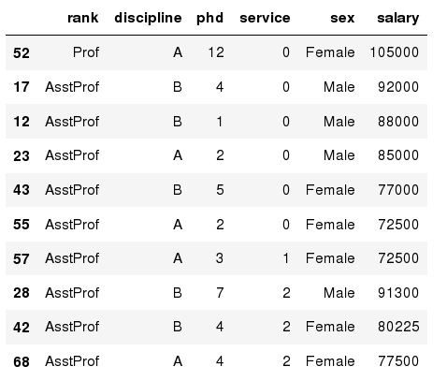
Data Frames: Sorting
In [ ]:
df_sorted = df.sort_values( by =['service', 'salary'], ascending = [True, False])
df_sorted.head(10)
Out[ ]:
Notes:
We can sort the data using 2 or more columns.

Slide 25
Missing Values
In [ ]:
# Read a dataset with missing values
flights = pd.read_csv("http://rcs.bu.edu/examples/python/data_analysis/flights.csv")
In [ ]:
# Select the rows that have at least one missing value
flights[flights.isnull().any(axis=1)].head()
Out[ ]:
Notes:
Missing values are marked as NaN.

Slide 26
Missing Values
df.method() | description
dropna() | Drop missing observations
dropna(how='all') | Drop observations where all cells is NA
dropna(axis=1, how='all') | Drop column if all the values are missing
dropna(thresh = 5) | Drop rows that contain less than 5 non-missing values
fillna(0) | Replace missing values with zeros
isnull() | returns True if the value is missing
notnull() | Returns True for non-missing values
Notes:
There are a number of methods to deal with missing values in the data frame.
When summing the data, missing values will be treated as zero;
If all values are missing, the sum will be equal to NaN;
cumsum() and cumprod() methods ignore missing values but preserve them in the resulting arrays;
Missing values in GroupBy method are excluded (just like in R);
Many descriptive statistics methods have skipna option to control if missing data should be excluded . This value is set to True by default (unlike R).

Slide 27
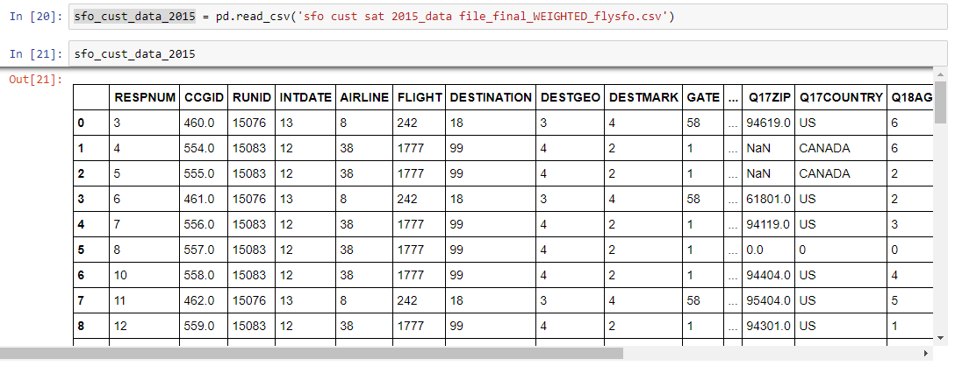
Importing the Data from CSV file
Notes:
Pandas is an opensource library that allows to you perform data manipulation in Python. Pandas provide an easy way to create, manipulate and delete the data.
Reading the CSV into a pandas DataFrame is very quick and easy.
Using the read_csv() function from the pandas package, you can import tabular data from CSV files into pandas dataframe by specifying a parameter value for the file name.

Slide 28
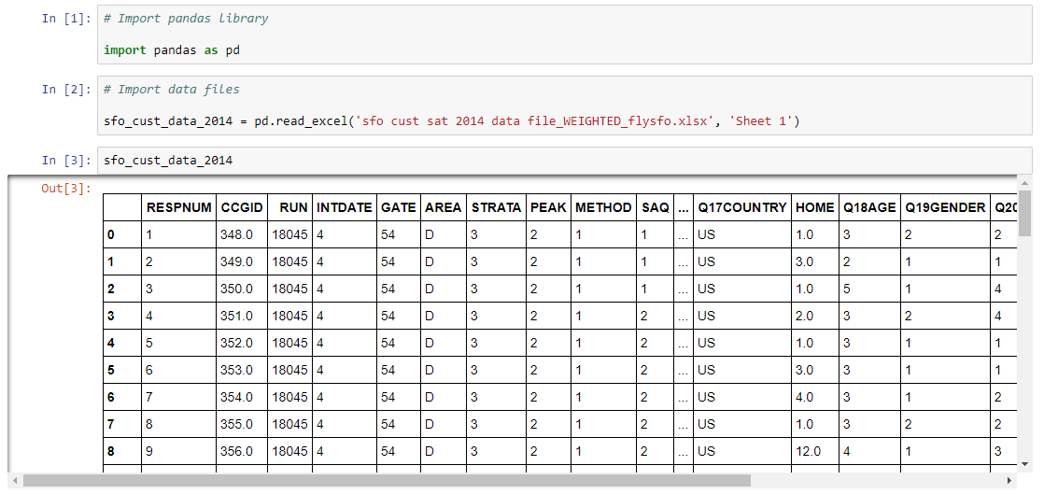
Importing the Data from Excel file
Notes:
You can easily import an Excel file into Python using Pandas. In order to accomplish this goal, you’ll need to use read_excel.
The method read_excel() reads the data into a Pandas Data Frame, where the first parameter is the filename and the second parameter is the sheet.

Slide 29
Importing the Data from JSON file
import json
with open('path_to_file/person.json') as f:
data = json.load(f)
# Output: {'name': 'Bob', 'languages': ['English', 'Fench']}
print(data)
Notes:
The full-form of JSON is JavaScript Object Notation. It means that a script (executable) file which is made of text in a programming language, is used to store and transfer the data. Python supports JSON through a built-in package called json. To use this feature, we import the json package in Python script. The text in JSON is done through quoted string which contains the value in key-value mapping within brackets.
You can use json.load() method to read a file containing JSON object.
Here, we have used the open() function to read the json file. Then, the file is parsed using json.load() method which gives us a dictionary named data.

Slide 30
REFERENCES
Link: [https://www.guru99.com/what-is-data-analysis.html#:~:text=Data%20analysis%20is%20defined%20as,based%20upon%20the%20data%20analysis.]
Katia Oleinik “Python for Data Analysis” Taken from Slides at Boston University
Samuel G. Mori, CISA, Managing Partner, Analytics & Advisory Services, Spyrion LLC, April 12, 2018
Link: [http://makemeanalyst.com/data-science-with-python/python-libraries-for-data-analysis/]
https://www.programiz.com/python-programming/json

