Slide 1
General Characteristics of Research
Lecture 2
Lecturer: Madina Askarovna, PhD, professor
Created by Zhanar Gabit, doctorate 2 year

Slide 2
PLAN OF THE LECTURE
Characteristics of the research process
01
Objectives
02
03
04
Research paradigms
Basic forms of research

Slide 3
01
Objectives
1. To identify the characteristics and requirements of the research process
2. To define the types of research from the perspective of applications, objectives and enquiry modes
3. To find the forms and methods of research

Slide 4
CHARACTERISTICS OF THE RESEARCH PROCESS
02

Slide 5
To qualify the research process, it must have certain characteristics to be: 1. Controlled 2. Rigorous 3. Systematic 4. Valid and verifiable 5. Empirical 6. Critical

Slide 6
1. Controlled
The concept of controlling implies to minimize the external effects which can affect the
relation­ship between your variables. This can be achieved when the research is being done in a laboratory. However, in the social sciences it is extremely difficult as research is car­ried out on issues relating to human beings living in society, where such controls are impos­sible. Therefore, in the social sciences, as you cannot control external factors, you attempt to quantify their impact.

Slide 7
2. RIGOROUS
The research has to be designed to find answers to questions that are relevant, appropriate and justified
5. EMPIRICAL
This means that any conclusions drawn are based upon hard evidence gathered from information collected from real-life experiences or observations
3. SYSTEMATIC
This implies that the procedures adopted to undertake an investigation follow a certain logical sequence
4. VALID AND VERIFIABLE
6. CRITICAL
Critical scrutiny of the procedures used and the methods employed is crucial to a research enquiry. It must be free from any drawbacks.
This concept implies that the finding of the research is correct and can be verified by others

Slide 8
Types of Research
Types of research are the different methodologies used to conduct research. There are 19 types of research among which the two are basic. All other types of research can be defined as fundamental or applied, depending on the goals of the study.
Fundamental research
Fundamental, or basic, research is designed to help researchers better understand certain phenomena in the world; it looks at how things work.
Applied research
Applied research is designed to identify solutions to specific problems or find answers to specific questions. The research is meant to offer knowledge that is applicable and implementable.

Slide 9
Qualitative research
Qualitative research involves nonnumerical data,
such as opinions and literature. Examples of qualitative data may include:
Focus groups
Surveys
Participant comments
Observations
Interviews
Quantitative research
Quantitative research depends on numerical data, such as statistics and measurements. For example, a car manufacturer may compare the number of sales of red sedans compared to white sedans. The research uses objective data—the sales figures for red and white sedans—to draw conclusions.
Mixed research
Mixed research includes both qualitative and quantitative data. Consider the car manufacturer comparing sedan sales. The company could also ask car buyers to complete a survey after buying a red or white sedan that asks how much the color impacted their decision and other opinion-based questions.

Slide 10
Exploratory research
Exploratory research is designed to examine what is already known about a topic and what additional information may be relevant. It rarely answers a specific question, but rather presents the foundational knowledge of a subject as a precursor to additional research. Often, exploratory research applies to lesser known issues and phenomena.
Longitudinal research
Longitudinal research focuses on how certain measurements change over time without manipulating any variables. For instance, a researcher may examine if and how employee satisfaction changes in the same employees after one year, three years and five years with the same company.
Cross-sectional research
Cross-sectional research studies a group or subgroup at one point in time. Participants are generally chosen based on certain shared characteristics, such as age, gender or income, and researchers examine the similarities and differences within groups and between groups. The group is often used as a representation of a larger population. Similar to longitudinal research, researchers observe participants without altering variables.

Slide 11
Field research
Field research takes place wherever the participants or subjects are, or "on location." This type of research requires onsite observation and data collection.
Laboratory research
Laboratory research takes place in a controlled laboratory setting rather than in the field. Often, the study demands strict adherence to certain conditions, such as elimination of variables or timing conditions. Laboratory research includes chemical experimentation and pharmacological research.
Fixed research
Fixed research involves experiment procedures that are determined ahead of time, such as how often testing will take place, where testing will take place, number of subjects and types of subjects. The research depends on precise conditions and compliance with predetermined protocols to reduce variables. Generally, fixed research is more reliable and replicable than flexible research. Experimentation is often fixed research.

Slide 12
Flexible research
Flexible research allows procedures to change throughout the course of the experiment. The different types of flexible research include:
Case studies: Case studies are in-depth analyses and observations about a specific individual or subject.
Ethnographic studies: Ethnographic studies are in-depth analyses and observations about a group of people.
Grounded theory studies: Grounded theory studies are designed to develop theories based on carefully collected and analyzed data.

Slide 13
Action research
Action research refers to the process of examining your actions, assessing their effectiveness in bringing about the desired outcome and choosing a course of action based on your results. Action research is typically used in educational settings for teachers and principals to perform a type of self-assessment and course correction.
Policy research
Policy research is designed to examine the effects of current government or social policies or predict the potential effects of proposed policies as those effects relate to the distribution or redistribution of resources. Policy researchers often work within government agencies and conduct the following types of studies:
Cost analysis
Cost-benefit analysis
Program evaluation
Needs analysis

Slide 14
Classification research
Classification research seeks to identify and classify individual elements of a group into larger groups or subgroups.
Comparative research
Comparative research is designed to identify similarities and differences between two individuals, subjects or groups.
Causal research
Causal research, also called explanatory research, seeks to determine cause and effect relationships between variables. This research is designed to identify how much one variable may cause a change in the other. Causal research is important for evaluating current processes and procedures and determining if and how changes should take place.

Slide 15
Inductive research
Inductive research, also known as theory-building research, is designed to collect data that may help develop a new theory about a process or phenomenon. This type of research examines observations and patterns and offers several hypotheses to explain these patterns. Inductive research moves from the specific to the general.
Deductive research
Deductive, or theory-testing, research is the opposite of inductive research and moves from the broad to the specific. Researchers choose a hypothesis and test its accuracy through experimentation or observation.

Slide 16
RESEARCH PARADIGMS

Slide 17
What Is a Scientific Paradigm?
Paradigm traces to a Greek verb meaning "to show," and has been used in English to mean "example" or "pattern" since the 15th century.
Paradigm is defined as a pattern or example. But in scientific field it implies to a philosophical and theoretical framework of a scientific school or discipline within which theories, laws, and generalizations and the experiments performed in support of them are formulated.

Slide 18
A research paradigm is a philosophical framework that the research is based on. It offers a pattern of beliefs and understandings from which the theories and practices of the research project operate.

Slide 19
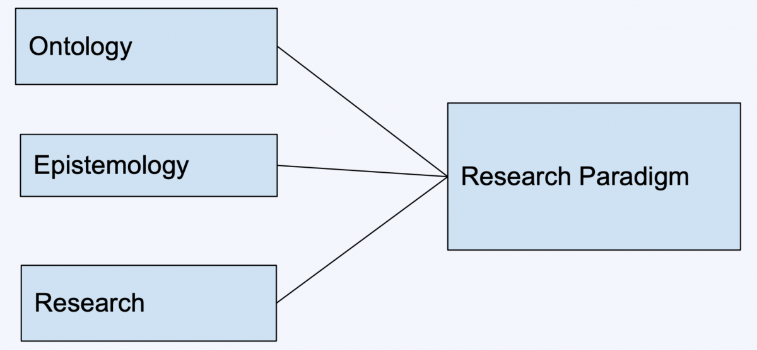
A research paradigm consists of ontology, epistemology, and research methodology.

Slide 21
Types of Research Paradigm
Positivist Paradigm
Constructivist Paradigm
Most of the scientific or quantitative research use positivism as a conceptual framework for research. Quantitative research always follows positivist approach because positivists believe in the empirical hypothesis testing. In pure sciences, positivism is preferred because of its empirical nature to study facts.
Most of the qualitative research in social sciences use constructivism approach to research. Constructivists believe that human behavior is multilayered and it cannot be determined by pre-defined probabilistic models. It depends on the situations and is determined by environmental factors other than the genes.

Slide 22
BASIC FORMS OF RESEARCH
Five Basic Forms of Research Studies
Case Studies.
Correlational Studies.
Longitudinal Studies.
Experimental Studies.
Clinical Trial Studies.

Slide 23
1. CASE STUDIES
Case studies look at a single subject (e.g., a child with autism) or a single case (e.g., a classroom for children with autism). Case studies are typically used in research that describes the development of an individual, group, or situation over a period of time in order to provide a detailed account of what is occurring within its real-life context.
The advantage of a case study is that it allows the researcher to gather a lot of information about one person or one case.
The disadvantage of a case study is that the information gathered about one person or a small group of people cannot readily be applied or generalized to other people or other cases in other situations or other settings and, therefore, may be of limited use.

Slide 24
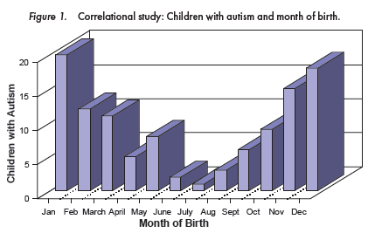
2. CORRELATIONAL STUDIES
Correlational studies look for a relationship between two or more variables, or things, that naturally occur in the same environment. Correlational studies cannot tell us anything about cause and effect, only that there is a relationship between two or more things. For example, a study might be designed to determine if there is a relationship between the number of children with autism in a particular community and the month of their birth.

Slide 25
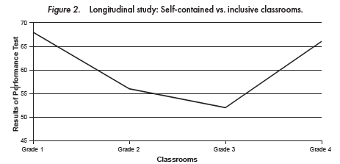
3. LONGITUDINAL STUDIES
Longitudinal studies can give us information about how people develop over time. These types of studies follow one group of people (referred to as a cohort) across time, measuring the same behavior multiple times. For example, we may want to determine if children with autism do better on performance tests in self-contained than in inclusive classrooms. The best research design for answering this question would be to follow one cohort of children with autism that spent time in both environments.

Slide 26
4. EXPERIMENTAL STUDIES
Experimental studies are controlled so that the researcher manipulates one variable to determine its effect on other variables. Two primary types of experimental studies are used in intervention development and testing: randomized group design and single-case design.

Slide 27
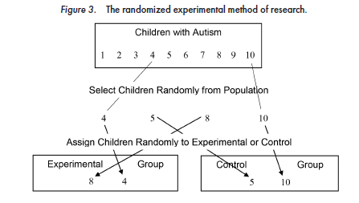
5. CLINICAL TRIAL STUDIES
Clinical trial studies are one specific type of randomized group experimental study. Clinical trial studies are most likely to be conducted in medical or other clinical settings. Similar to experimental group design studies, clinical trial studies employ an experimental/control group, in which participants are randomly assigned to receive the experimental treatment (e.g., a medication to treat autism symptoms) or a placebo (a sugar pill).

Slide 28
Practical tasks:
Read the paper written by Scotland (2012)* and discuss the following aspects of educational research paradigms:
1. What are the three educational paradigms had been explored in this paper ?
2. “ Every paradigm is based upon its own ontological and epistemological assumptions”. Do you agree with this statement ? Give reasons for your answer.
3. What are the major differences that you have observed between positivism and post-positivism.
4. How would you describe ontological & epistemological positions of the Scientific paradigm and the Interpretive paradigm ?
5. Describe methodological underpinning of the critical paradigm and how it differ from the scientific and the interpretive paradigms.
*https://www.researchgate.net/publication/266221532_Exploring_the_Philosophical_Underpinnings_of_Research_Relating_Ontology_and_Epistemology_to_the_Methodology_and_Methods_of_the_Scientific_Interpretive_and_Critical_Research_Paradigms

Slide 29
References:
• Babbie E. (1998). The Practice of Social Research 98th Edition). Wadsworth Thomson. London.
• Kuhn, T. S. (1970) The Structure of Scientific Revolutions (2nd Edition) University of Chicago Press. Section V, pp. 43-51
• Crotty, M. (1989). The foundations of social research. London: Sage.
• Guba, E. G., & Lincoln, Y. S. (1994). Competing paradigms in qualitative research. In N. K. Denzin, & Y. S. Lincoln (Eds.), Handbook of qualitative research (pp. 105-117). London: Sage.
• Scotland, J. (2012). Exploring the Philosophical Underpinnings of Research: Relating Ontology and Epistemology to the Methodology and Methods of the Scientific, Interpretive, and Critical Research Paradigms. English Language Teaching; Vol. 5, (9), pp. 9-16
• Uyangoda J. (2015). Social Research: Philosophical and Methodological Foundations. Social Scientists‟ Association. Colombo

Slide 30
Thanks!

