Slide 1
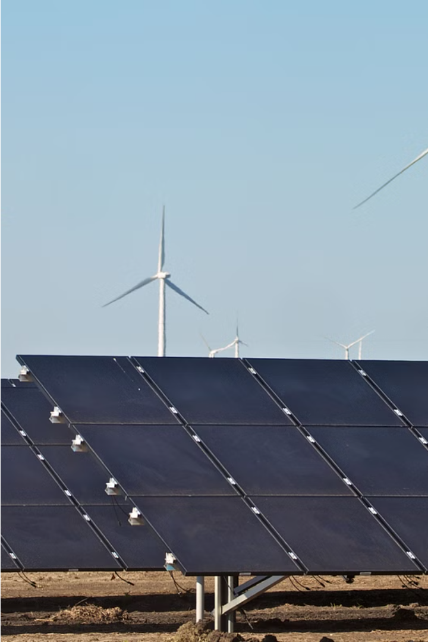
Information Security of Renewable Energy Sources
Renewable energy sources, such as solar, wind, and hydropower, are becoming increasingly important in the fight against climate change. However, these technologies also face cybersecurity risks that must be addressed to ensure the reliability and security of the energy grid.

Slide 2
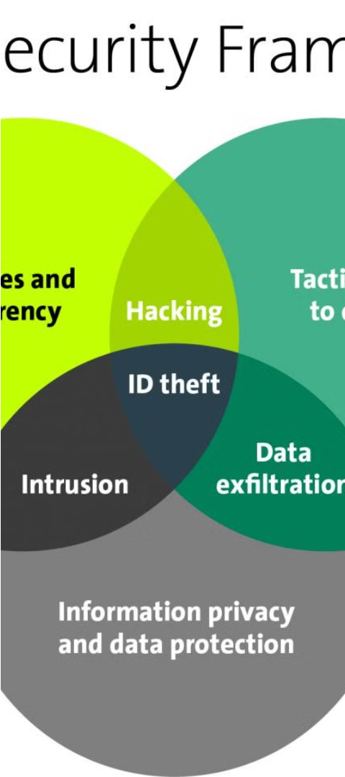
Vulnerabilities in Renewable Energy Systems
1
Distributed Infrastructure
2
Interconnected Networks
Renewable energy sources are connected to the broader energy grid, exposing them to potential cyberattacks on the grid infrastructure.
Renewable energy systems are often geographically distributed, making them vulnerable to cyber attacks on multiple entry points.
3
Legacy Equipment
Many renewable energy systems rely on older, legacy equipment that may lack modern cybersecurity protections.

Slide 3
Securing Renewable Energy Systems
Access Control
Encryption
Monitoring and Logging
Implementing robust access control measures, such as multifactor authentication and role-based permissions, to limit unauthorized access to critical systems.
Ensuring that all data transmitted between renewable energy systems and the grid is encrypted to prevent eavesdropping and data manipulation.
Implementing comprehensive monitoring and logging systems to detect and respond to cyber threats in real-time.

Slide 4
Industry Standards and Regulations
NERC-CIP
IEC 62351
The North American Electric Reliability Corporation's Critical Infrastructure Protection (NERC-CIP) standards provide guidelines for securing the energy grid, including renewable energy systems.
The International Electrotechnical Commission's IEC 62351 standard addresses cybersecurity for power system communication protocols, helping to secure renewable energy systems.
NIST Cybersecurity Framework
ISO/IEC 27001
The National Institute of Standards and Technology's Cybersecurity Framework provides a comprehensive approach to managing cybersecurity risks in renewable energy and other critical infrastructure.
The ISO/IEC 27001 standard for information security management systems can help renewable energy companies implement robust security controls and processes.

Slide 5
Emerging Threats to Renewable Energy
Ransomware
Advanced Persistent Threats
Malware that encrypts data and demands a ransom payment, potentially disrupting renewable energy operations.
Sophisticated, targeted cyber attacks that aim to gain long-term access to renewable energy systems for espionage or sabotage.
1
2
3
IoT Botnets
Botnets of compromised Internet of Things (IoT) devices that can be used to launch distributed denial-of-service (DDoS) attacks on renewable energy systems.

Slide 6
Collaboration and Information Sharing
Industry Partnerships
Information Sharing
Workforce Development
Establishing secure platforms and protocols for sharing information about cyber threats and vulnerabilities within the renewable energy sector.
Collaboration between renewable energy providers, cybersecurity experts, and government agencies to share threat intelligence and best practices.
Investing in training and education to build a skilled workforce capable of addressing the unique cybersecurity challenges of renewable energy systems.

Slide 7
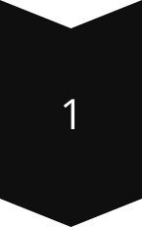
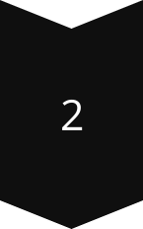
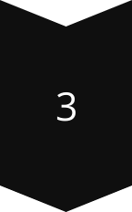
Case Study: Solar Energy Cybersecurity
Distributed Solar Arrays
Solar energy systems are often made up of geographically dispersed solar panels and inverters, creating multiple entry points for potential cyber attacks.
Remote Monitoring and Control
Solar energy systems rely on internet-connected devices for remote monitoring and control, increasing the risk of cyber intrusions.
Grid Integration Vulnerabilities
The integration of solar energy into the broader power grid exposes solar systems to threats targeting the grid infrastructure.

Slide 8
Addressing Cybersecurity in Wind Energy
Vulnerability
Impact
Mitigation Strategies
Connectivity of Wind Turbines
Remote access to turbine controls can enable attackers to disrupt operations
Implement strong access controls, network segmentation, and secure remote access protocols
Outdated Software and Firmware
Vulnerabilities in legacy systems can be exploited by attackers
Establish a robust patch management program and upgrade older equipment
Supply Chain Risks
Compromised components or software from third-party suppliers can introduce vulnerabilities
Vet suppliers, implement supply chain security measures, and monitor for third-party risks

Slide 9
Hydropower Cybersecurity Considerations
Dam Control Systems
Grid Integration
Physical Security
Hackers could potentially gain control of dam operation systems, leading to catastrophic flooding and damage.
Hydropower facilities are connected to the broader power grid, making them vulnerable to attacks targeting the grid infrastructure.
Dams and other hydropower infrastructure require robust physical security measures to prevent physical access and sabotage.

Slide 10
The Future of Renewable Energy Cybersecurity
Artificial Intelligence and Machine Learning
Blockchain-based Solutions
Exploring the use of blockchain technology to improve the security and transparency of renewable energy transactions and grid operations.
Leveraging AI and ML to enhance real-time threat detection, automated response, and predictive security capabilities in renewable energy systems.
Edge Computing and IoT Security
Zero Trust Architecture
Implementing a zero-trust approach to security, where every user, device, and application is continuously verified, to better protect renewable energy infrastructure.
Addressing the unique security challenges posed by the proliferation of Internet of Things (IoT) devices in renewable energy systems.

