Slide 1
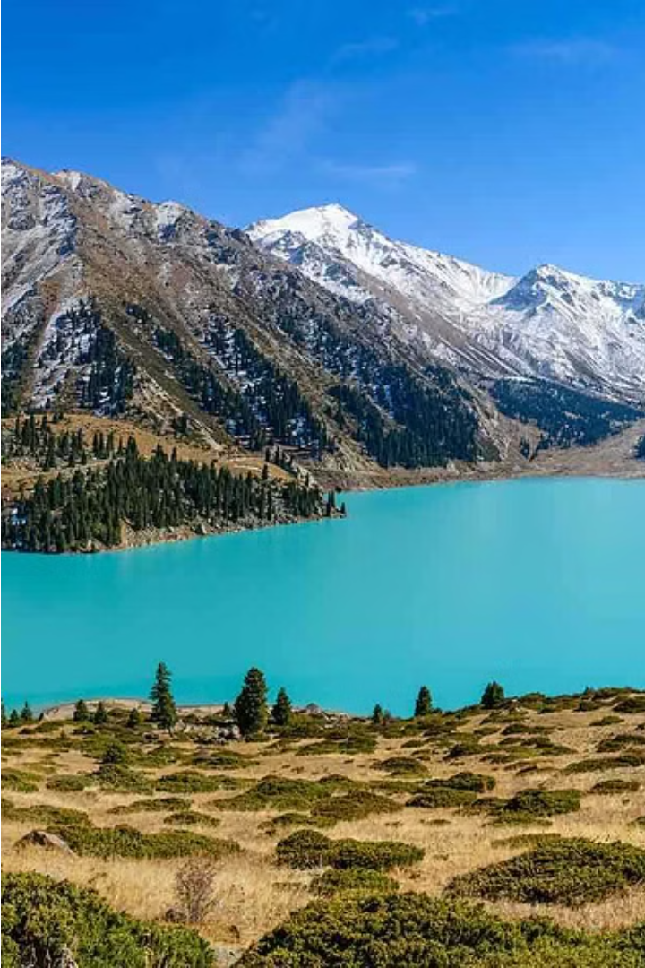
Information Security of Kazakhstan's Ecological and Energy Space
Kazakhstan, a Central Asian nation, faces the dual challenge of ensuring the security of its ecological and energy systems. This presentation explores the key aspects of this critical issue for policymakers, researchers, and industry professionals.

Slide 2
Renewable Energy Potential
Solar Power
Wind Energy
Hydropower
Kazakhstan's vast desert and steppe regions receive abundant sunlight, making solar energy a promising renewable resource.
The country's windy landscapes provide significant potential for wind power generation, particularly in the west and north.
Kazakhstan's mountainous terrain and river systems offer opportunities for small-scale and run-of-river hydroelectric projects.

Slide 3
Ecological Vulnerabilities
1
Desertification
2
Water Scarcity
3
Ecosystem Degradation
Expanding deserts pose a threat to arable land and biodiversity, requiring comprehensive land management strategies.
Efficient water usage and conservation measures are crucial to address the country's limited freshwater resources.
Overexploitation of natural resources and pollution have led to the deterioration of Kazakhstan's diverse ecosystems.

Slide 4
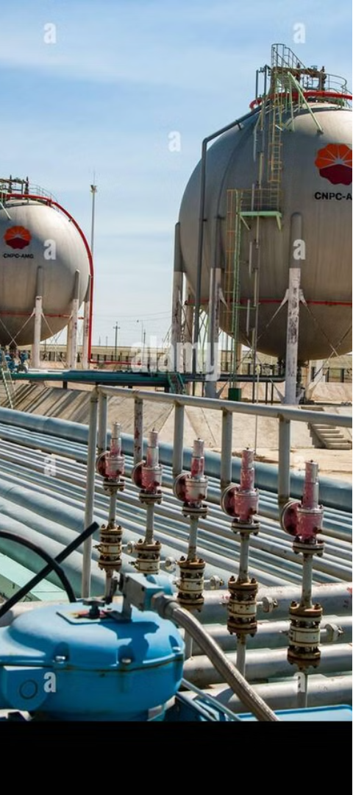
Energy Infrastructure Resilience
Grid Modernization
Cybersecurity
Upgrading the country's electricity grid to incorporate renewable sources and improve reliability is a key priority.
Protecting critical energy infrastructure from cyber threats is essential for ensuring uninterrupted energy supply.
Diversification
Diversifying the energy mix by reducing reliance on fossil fuels can enhance Kazakhstan's energy security.

Slide 5
Sustainable Development Strategies
Policy Reforms
Implementing policies that incentivize renewable energy and promote environmental conservation are crucial.
Technological Innovations
Investing in research and development of clean technologies can drive sustainable energy and ecological solutions.
Public-Private Partnerships
Collaborations between the government, industry, and academia can accelerate the transition to a sustainable future.

Slide 6
Ecological Monitoring and Enforcement
Satellite Surveillance
Sensor Networks
Regulatory Compliance
Utilizing satellite technology to monitor environmental conditions and detect violations can aid enforcement efforts.
Deploying sensor networks to collect real-time data on air, water, and soil quality can support evidence-based policymaking.
Strengthening environmental regulations and ensuring adherence can help protect Kazakhstan's natural resources.

Slide 7
Energy Efficiency Initiatives
Building Retrofits
Transportation Transformation
Improving the energy efficiency of residential and commercial buildings through retrofits can reduce energy consumption.
Promoting electric vehicles, public transportation, and sustainable mobility options can decrease fossil fuel dependence.
1
2
3
Industrial Optimization
Implementing energy-efficient technologies and processes in the industrial sector can improve productivity and lower emissions.

Slide 8
Stakeholder Engagement and Capacity Building
Policymakers
Develop comprehensive plans and policies that integrate energy security and environmental protection.
Industry Leaders
Invest in clean technologies, adopt sustainable practices, and collaborate with government and communities.
Local Communities
Participate in decision-making, embrace sustainable lifestyles, and serve as stewards of the local environment.

Slide 9
International Cooperation and Knowledge Sharing
Regional Partnerships
Global Initiatives
Knowledge Exchange
Collaborating with neighboring countries to address cross-border environmental and energy challenges can yield shared solutions.
Actively participating in international forums and implementing best practices can strengthen Kazakhstan's position as a leader in sustainability.
Fostering knowledge exchange with global experts can help Kazakhstan develop innovative approaches to energy and ecological security.

Slide 10
A Sustainable Future for Kazakhstan
By addressing the interconnected challenges of energy security and environmental protection, Kazakhstan can build a resilient and sustainable future that benefits its people and the planet. Through innovative policies, strategic investments, and collaborative efforts, the country can lead the way in Central Asia's transition to a green economy.

