Slide 1
Hydrogen Energy Storage
Abdulnaser Sayma
Professor of Energy Engineering

Slide 2
Consents
Introduction
The Principles of Hydrogen Energy Storage
Performance Characteristics
Applications
Conclusions

Slide 3
Introduction - I
Most electrical energy storage technologies, other than direct storage of electricity, rely on converting electrical energy to another form of energy and then converting back to electricity.
Hydrogen offers a more general means of energy storage covering a wider range than just electricity to X to electricity. Examples:
Hydrogen can by produced using a thermal process
Stored hydrogen can be used to generate heat only
In this lesson, we will focus on the use of Hydrogen for electricity storage.
Hydrogen is attractive because its use does not lead to CO2 emissions
Due to many practical and economic factors, the extent to which hydrogen can play a role in the future energy storage scenario is not certain
Feasibility requires the development of what is now known as ‘the Hydrogen Economy’, where fossil fuels are replaced by Hydrogen

Slide 4
Introduction - II
Hydrogen does not exist naturally in large amounts to make it directly used as a fuel
It’s production from other compounds that contain the element require energy.
For economic reasons, most hydrogen produced today for various purposes is produced from natural gas. However, a byproduct of that process is carbon dioxide.
Hydrogen is produced in relatively small amount, due to high costs, by electrolysis of water to Hydrogen and Oxygen

Slide 5
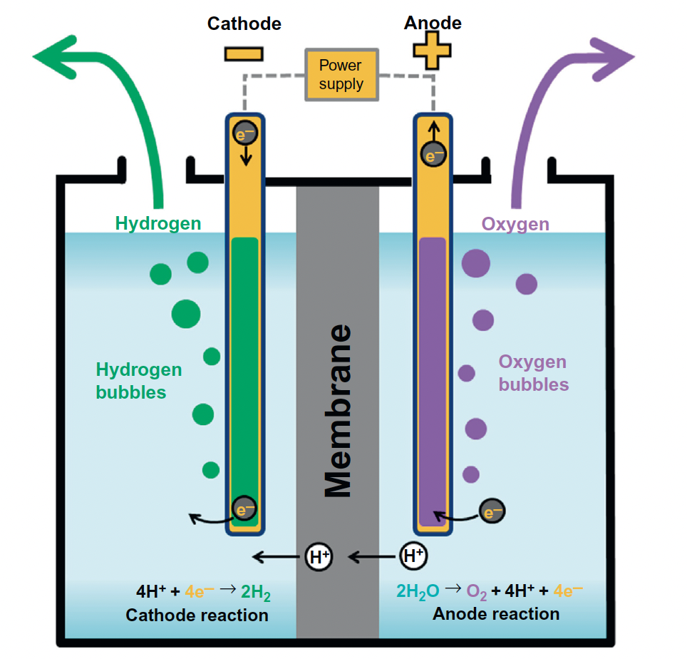
The principles of Hydrogen Energy Storage - I
Let’s start first with explaining how electrolysis works

Slide 6
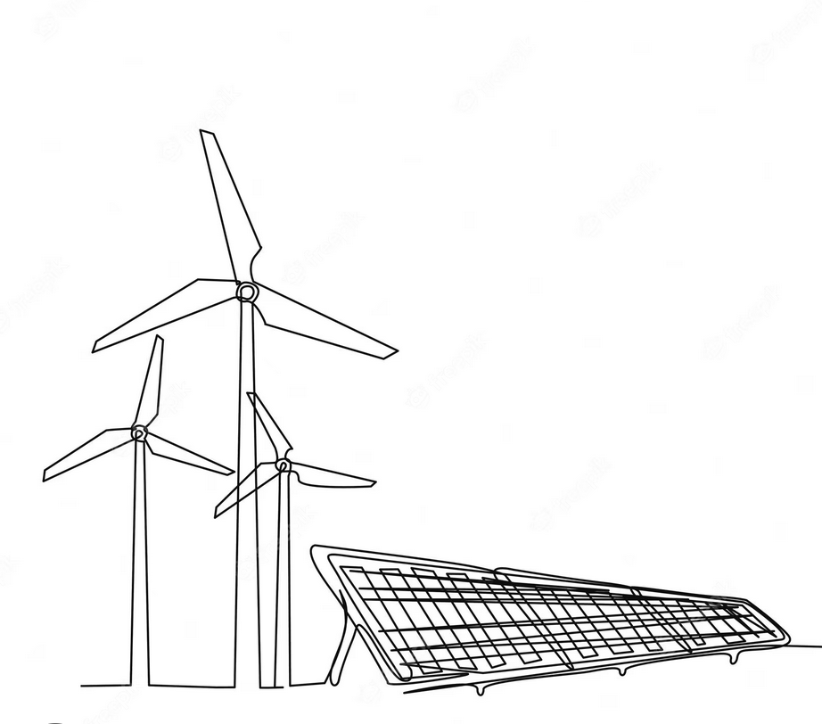
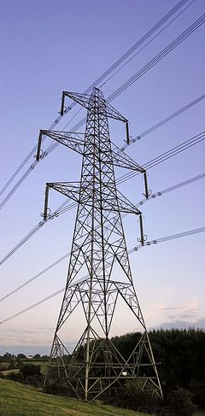
The principles of Hydrogen Energy Storage - II
Combine for easy storage and transport
Release
Transport/distribute
Electricity generation:
Combustion Engines, Fuel cells
Electricity
Electrolysis
Storage
Hydrogen
Transport/distribute
Storage
Water
Oxygen
Electricity for transport

Slide 7
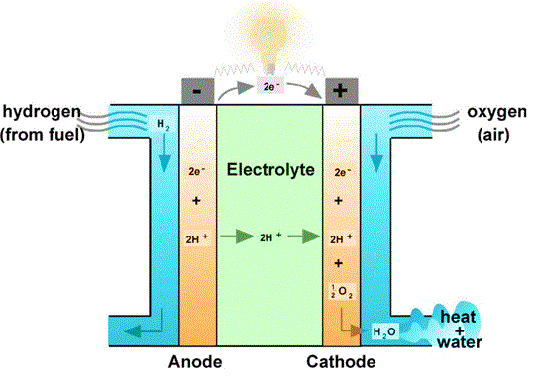
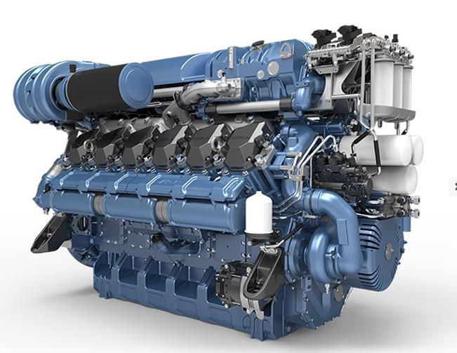
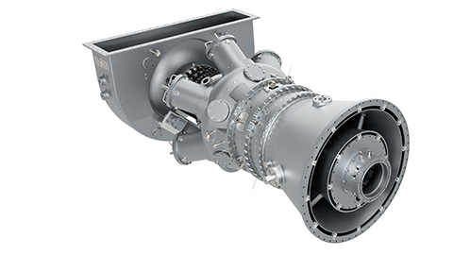
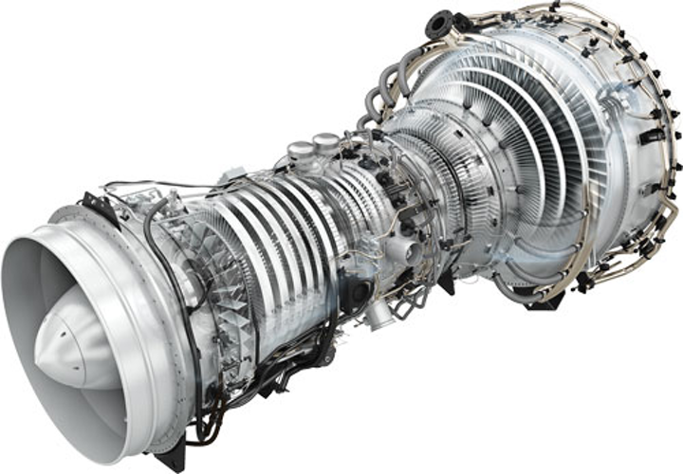
Conversion to electricity
Fuel Cells: Several types, commercially available, but still expensive
Combustion Engines:
Reciprocating Engines
Gas Turbines

Slide 8
Performance Characteristics
Electrical energy storage systems are typically characterized by their storage capacity, response time and rate of power delivery to the gird
As hydrogen can use multiple types of technologies to deliver electricity to the grid, the performance characteristics will depend on the type of technology used.
Fuel cells can provide better performance compared to combustion engines in terms of:
Can be started quickly and can respond to changes in demand quickly
Offer relatively constant efficiency at a wide operating range.
However, they are still expensive and typically much smaller in capacity requiring stacking to achieve grid scale power.
Hydrogen offers the opportunity for very large storage capacity and unlike most other energy storage systems, it can be transported to various locations including cross country.
Round cycle efficiency is around 54% which is lower than many other large scale energy storage systems

Slide 9
Applications
The most viable use of hydrogen currently is in industrial processes, and hydrogen used this way is typically produced by reforming fossil fuels due to cost considerations
Other important uses is fuel for vehicles. Fuel cell cars are commercially available, but they are still expensive and face the challenge of the large size storage tank required.
For future electricity grid scale storage, the economics are still not clear. A case may be made for storing excess wind energy that otherwise would be shed.
Hydrogen energy storage for electricity may become viable if the hydrogen economy comes to existence.

Slide 10
Conclusions
Hydrogen offers a conceptually different electrical energy storage option compared to other technologies
The main path from renewables is electrolysis of water.
Hydrogen can be compressed, stored and transported, or it can be combined with other materials for easier storage and transport, but need small amounts of energy to release for use
Hydrogen can be converted to electricity in fuel cells or modified combustion engines
The economic case for hydrogen as electricity storage vehicle is still not clear

