Slide 1
Концепция Game Engine в Unity.

Slide 2
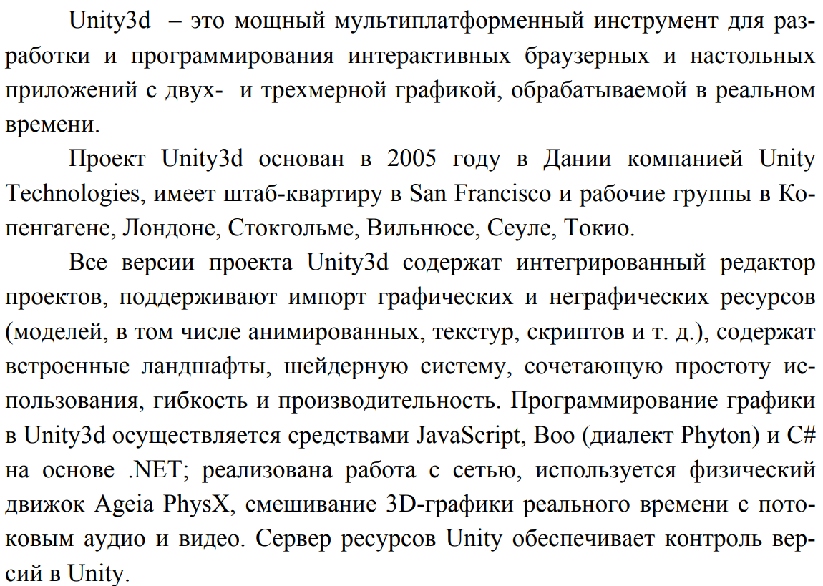

Slide 3
Концепция Game Engine в Unity3d

Slide 4
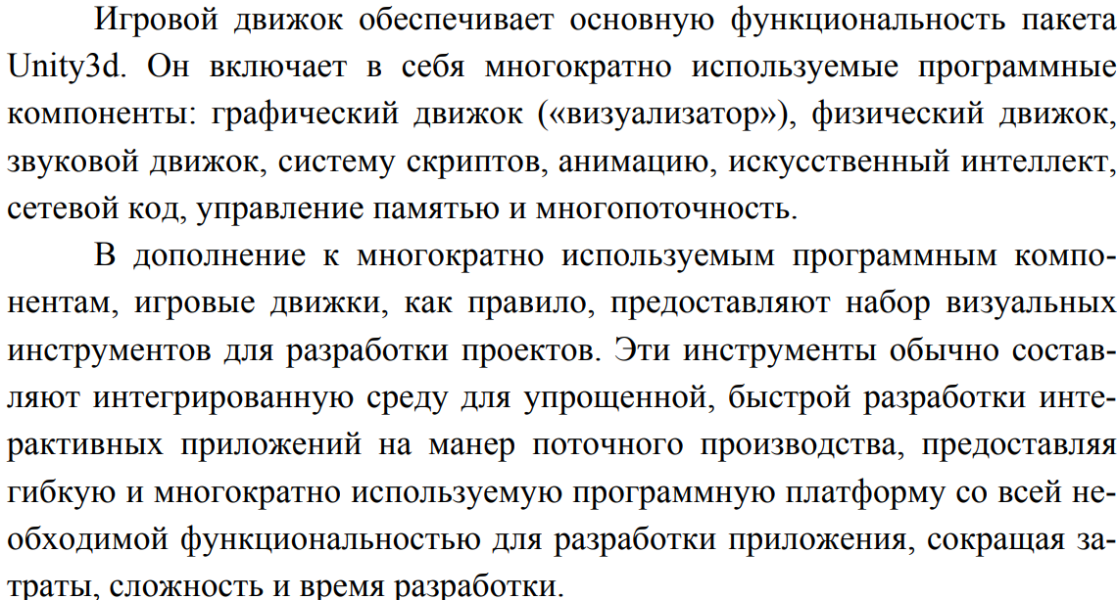
Концепция Game Engine в Unity3d

Slide 5
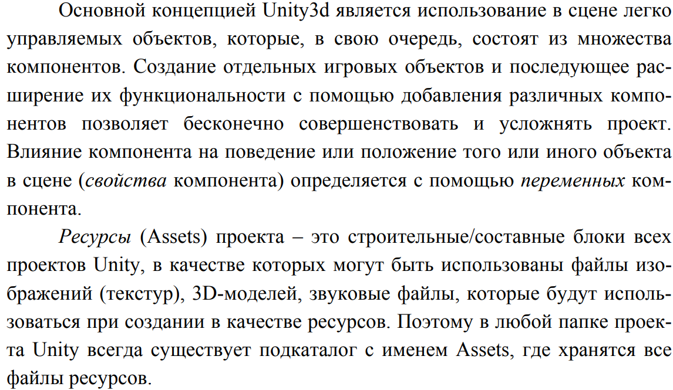
Концепция Game Engine в Unity3d

Slide 6
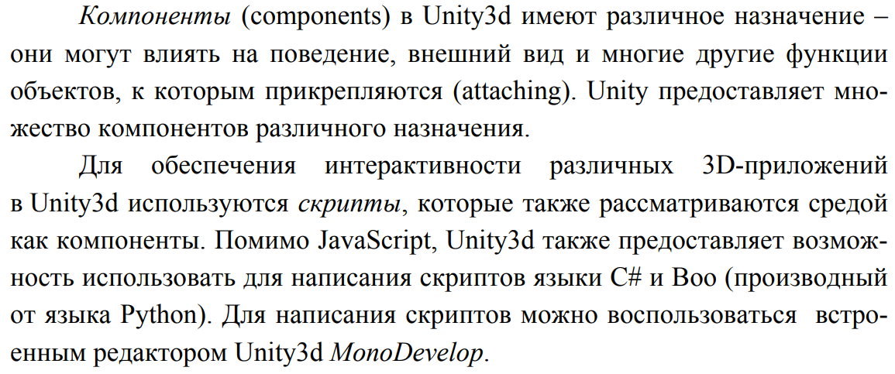
Концепция Game Engine в Unity3d

Slide 7
Концепция Game Engine в Unity3d

Slide 8
Концепция Game Engine в Unity3d

Slide 9
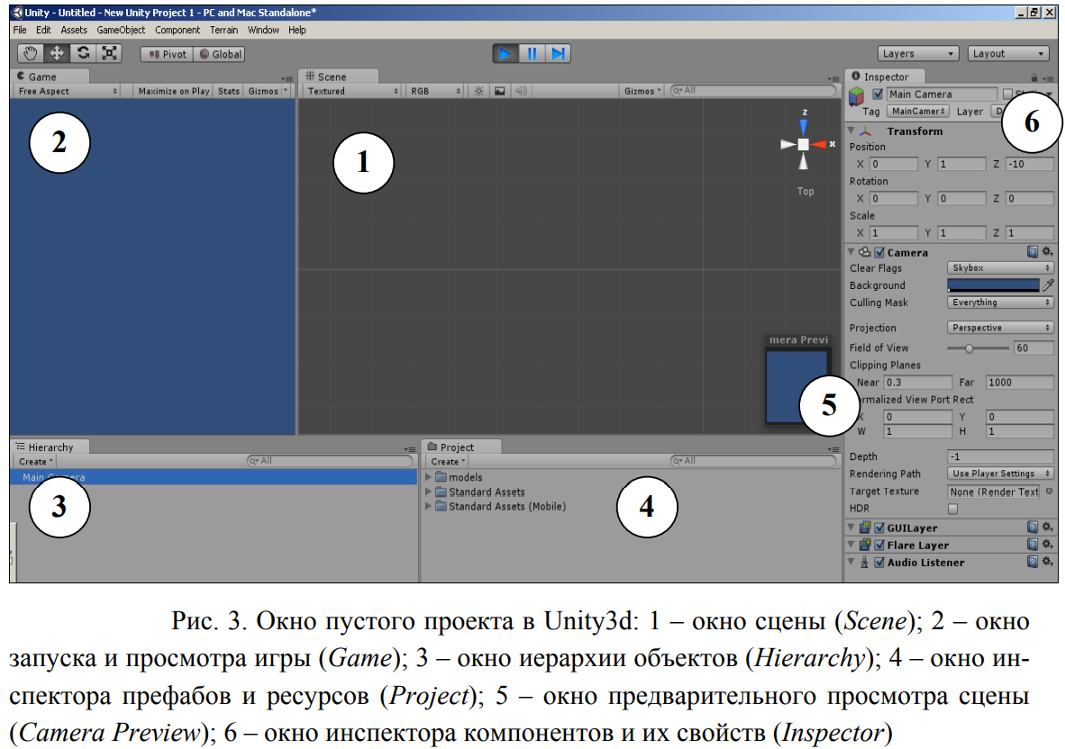
Концепция Game Engine в Unity3d

Slide 10
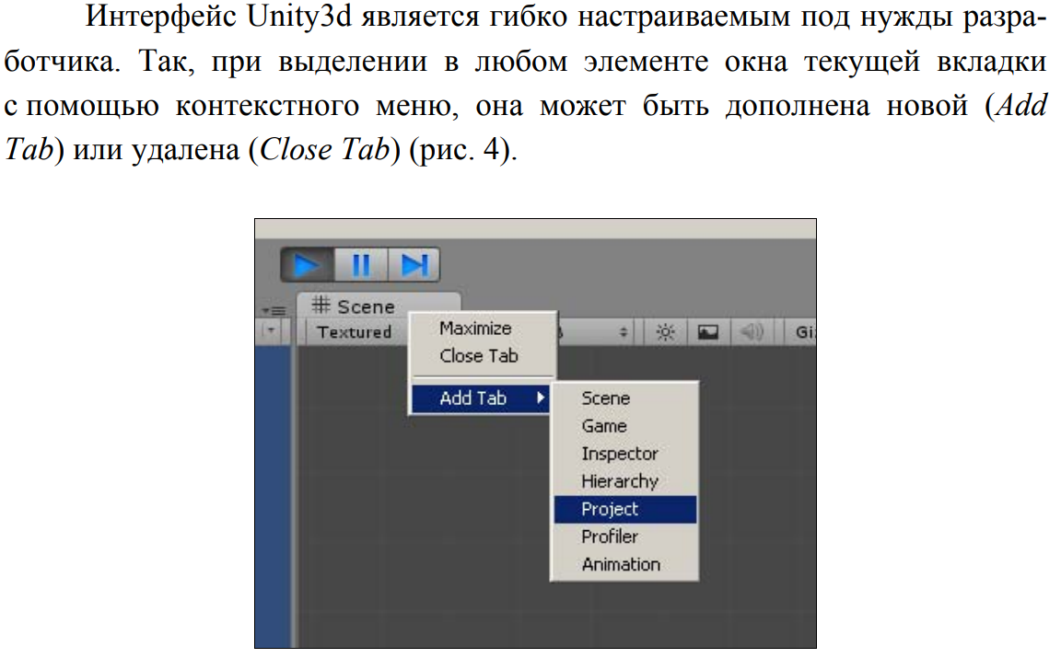
Концепция Game Engine в Unity3d

Slide 11
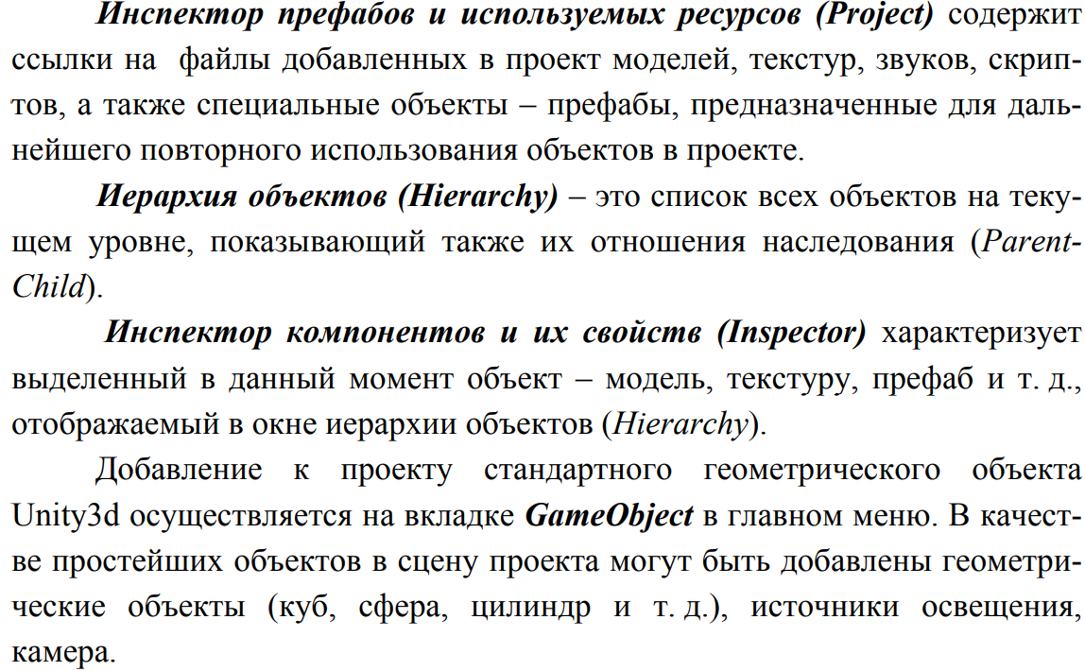
Unity

Slide 12
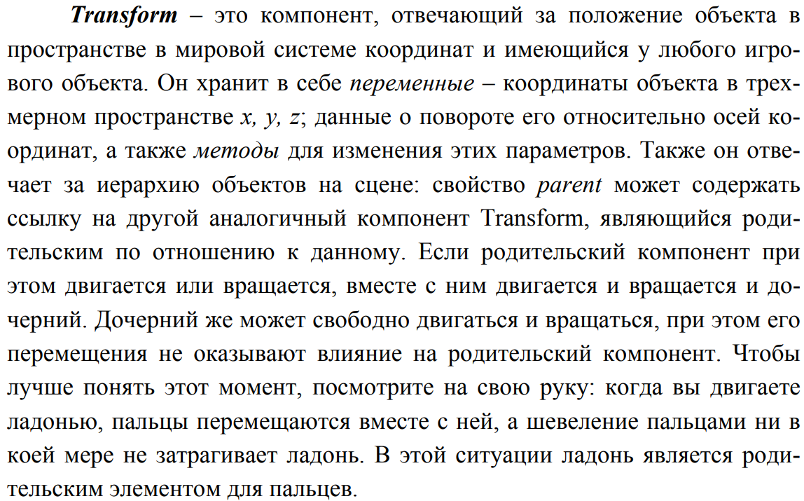
Unity

Slide 13
Workflow
Unity is powerful, complete game development system
Create 3D objects / scenes in Unity
Or import objects created in 3D modelling packages
Use scripting to control animations / scene changes etc.
Export to stand alone game, or web page component, or mobile app

Slide 14
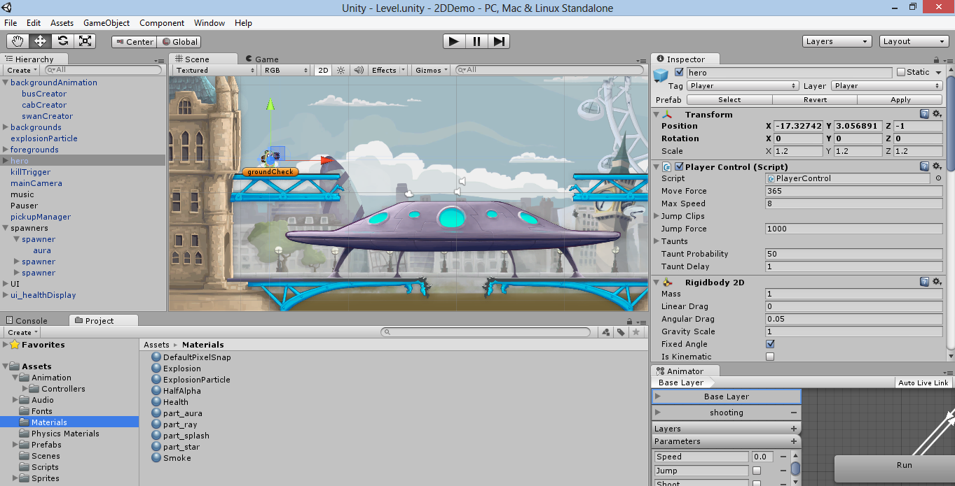
Main interface

Slide 15
Unity actually is the union of
(1) a game engine, that allows game created to run (hence to be played) in different environments,
(2) an application where the “visible pieces” of a game can be put together (the IDE) with a graphical preview and using a controlled “play it” function, and
(3) a code editor

Slide 16
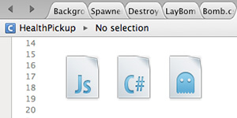
Scripting
The game engine's scripting is built on Mono, the open-source implementation of the .NET Framework. Programmers can use:
UnityScript (a custom language with syntax, referred to as JavaScript by the software)
C#
Boo (which has a Python-inspired syntax)

