Slide 1
L.N. Gumilyov Eurasian National University Department of State Audit Examination phase of performance audit
Subject: Performance audit fundamentals
Lecturer : doctor PhD Serikova M.A.

Slide 2
Agenda
Managing the audit engagement
Documenting the audit process and the audit evidence

Slide 3
Audit examination Phase

Slide 4
Purpose of and approach to the examination phase
The purpose of the examination stage is to gather sufficient, relevant and reliable audit evidence to allow the auditor to conclude on the audit questions and to support all the statements made in the audit report.

Slide 5
The nature of evidence in performance audits Data, information and audit evidence are interrelated, as follows:

Slide 6
Purpose of and approach to the examination phase
Detailed assessments of information needs should be carried out at both the audit planning and examination phases so that the auditors are not swamped by excessive data.
As well as facilitating the elimination of incidental details and irrelevant approaches, this will also contribute to the sorting and structuring of data collected.
It might be useful to hold discussions in advance with experts regarding the nature of the data to be obtained and the way in which it will be analysed and interpreted by the auditor, in order to reduce the risk of misunderstanding and potentially speed up the process.

Slide 7
Sufficiency, relevance and reliability of evidence
The concepts of quantity (sufficiency) and quality (relevance and reliability) in relation to audit evidence must be considered together, as an inverse relationship exists between them.
Thus, high-quality evidence can lead to a reduction in the need for a large quantity of evidence; a large quantity of evidence can sometimes, but not always, be persuasive, even though individual pieces of evidence are not of high quality.
the exercise of professional judgement is essential here as there are no precise guidelines to measure the degree of proof required.

Slide 8
Whilst the following concepts are often useful in assessing the quality of audit evidence, certain constraints may exist in their practical application:
original evidence is superior to photocopies, facsimiles, etc.;
documentary evidence is preferable to oral evidence.
However, correspondence, memos and reports may be incomplete, ambiguous or even incorrect, whilst interviews can provide an in-depth understanding not only of facts, but also of constraints and the environment. Nevertheless, evidence collected from interviews needs to be corroborated from other sources;
third-party evidence is better than that generated within the auditee organization.
However, in performance audits, limited use may be made of third-party confirmations, as information may only be available within the entity being audited. Furthermore, strong internal controls within the auditee organisation can improve the quality of information obtained;
evidence generated through the auditor's direct observation, inspection and computation is superior to evidence obtained indirectly.

Slide 9
In assessing the quantity and quality of audit evidence, the auditor needs to consider the following:

Slide 10
Sources of evidence

Slide 11
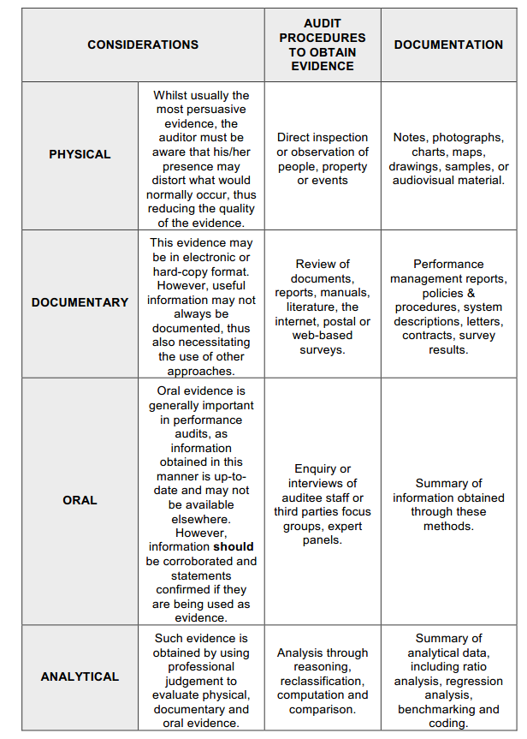
Types of evidence

Slide 12
Purpose of and approach to data collection and analysis
Both quantitative and qualitative data may be collected for different purposes, whether as part of the learning process to understand the audit subject, to assess and measure performance, or to document errors or problems already known (e.g. from the planning phase).
Prior to data collection, a general assessment of the internal control system, including IT, should be performed in order to identify risks that could compromise the integrity of the data

Slide 13
Data collection process
Evidence collection follows an iterative decision-making process, whereby auditors obtain data, examine it for completeness and appropriateness, analyse it, and make decisions on whether additional evidence is required
Auditors are encouraged to use computer-assisted audit techniques (CAATs) for collecting and analysing audit evidence whenever their use will increase the efficiency of the audit.

Slide 14
DOCUMENTING THE AUDIT
Good documentation of audit evidence helps to ensure that:
• a defensible basis exists for the audit findings and draft final report
contents (which is particularly important during the adversarial procedure);
• the audit findings, conclusions and recommendations can be explained;
• an appropriate basis exists for quality control both during the audit and for subsequent reviews (Quality Assurance, peer reviews).

Slide 15
Case
The auditor should evaluate the effectiveness of the execution of the state program for 2018-2020 according to the following criteria:
- achievement of indicators 0, 60 = 100%
-parameters of implementation of the program 0,40
Task: Determine the effectiveness of the program implementation using the arithmetic mean formula and the specific weight of each criterion.
1)(0,924 +1 +0,62+1+ 0,625)/5= 0,83
2 ) (0,986 +1+0, 73+0,70 + 0,50 )/5= 0,78
3) 0,83 * 0,60+ 0,78 *0,40 = 0, 81 = 81% - average level of effectiveness
 | Main indicators | Plan | factual
1 | The increase in GDP in real terms in 2009 to 2019 | 38,4 % | 35,5 % | 35,5/38,4= 92,4 0, 924
2 | Increase in the GVA of the non-resource sector | Growth is positive 100% |  | 1
3 | The increase in the manufacturing industry to 2019- 2009 | 43,6 | 27, 1 | 0,62
4 | Increase in labor productivity | 1,5 | 1,52 | 1,52/1,5= 1, 01 1
5 | Share of non-primary exports in the volume of exports | 40 % | 25% | 25/40= 0,625
№ | Implementation settings the program
 | Republican budget expenditures have been disbursed | 98,6 %
2 | employment creation | 100 %
3 | Ensuring timely receipt of borrowed funds | 73%
4 | The increase in tax revenues for projects | 70%
5 | Share of industrial and innovative projects | 50 %

