Slide 1
Introduction to Research General Concept
Lecture 1

Slide 2
Introduction to Research: General Concepts
What is research?
Characteristics of the research
Characteristics of scientific knowledge
General approaches to research

Slide 4
What is Research?
Research is "creative and systematic work undertaken to increase the stock of knowledge". It involves the collection, organization, and analysis of information to increase understanding of a topic or issue. A research project may be an expansion on past work in the field. To test the validity of instruments, procedures, or experiments, research may replicate elements of prior projects or the project as a whole. (WIKIPEDIA)

Slide 5
What is Research?
Research is the careful consideration of study regarding a particular concern or problem using scientific methods. According to the American sociologist Earl Robert Babbie, “research is a systematic inquiry to describe, explain, predict, and control the observed phenomenon. It involves inductive and deductive methods.”

Slide 6
Research is conducted with set of goals:

Slide 7
What are the characteristics of research?
Real-time data and knowledge is derived from actual observations in natural settings.
There is an in-depth analysis of all data collected so that there are no anomalies associated with it.
It creates a path for generating new questions. Existing data helps create more research opportunities.
It is analytical and uses all the available data so that there is no ambiguity in inference. Accuracy is one of the most critical aspects of research. The information must be accurate and correct. For example, laboratories provide a controlled environment to collect data. Accuracy is measured in the instruments used, the calibrations of instruments or tools, and the experiment’s final result.
Good research follows a systematic approach to capture accurate data.
Researchers need to practice ethics and a code of conduct while making observations or drawing conclusions.
The analysis is based on logical reasoning and involves both inductive and deductive methods.

Slide 8
RESEARCH CAN BE
INFORMAL
FORMAL

Slide 9
CHARACTERISTICS OF RESEARCH
Empirical – based on proven scientific methods derived from real-life observations and experiments.
Logical – follows sequential procedures based on valid principles.
Cyclic – research begins with a question and ends with a question, i.e. research should lead to a new line of questioning.

Slide 10
Controlled – vigorous measures put into place to keep all variables constant, except those under investigation.
Hypothesis-based – the research design generates data that sufficiently meets the research objectives and can prove or disprove the hypothesis. It makes the research study repeatable and gives credibility to the results.
Analytical – data is generated, recorded and analysed using proven techniques to ensure high accuracy and repeatability while minimising potential errors and anomalies.

Slide 11
Objective – sound judgement is used by the researcher to ensure that the research findings are valid.
Statistical treatment – statistical treatment is used to transform the available data into something more meaningful from which knowledge can be gained.

Slide 12
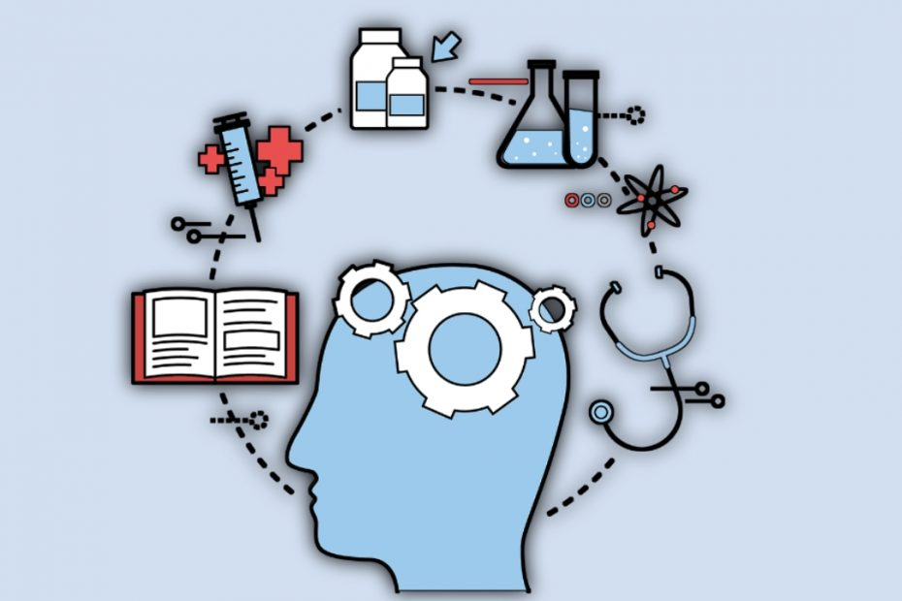
CHARACTERISTICS OF SCIENTIFIC RESEARCH
Major Characteristics of Scientific Knowledge: There are different types of researches and research methods that may be considered by a researcher.

Slide 13
The major characteristics of scientific knowledge includes the following:
Empirical
Accuracy
Ethical consideration
Predictable
Controlled
Objective
Systematic
Reliable
Replicable
and have a definite objective

Slide 14
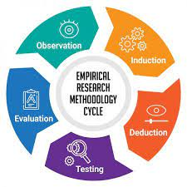
Empirical: A cardinal feature of a scientific research work is that it is empirical. Simply put, this means that it can be verifiable. Thus for a work to qualify as a scientific work, persons should be able to verify the truth or otherwise of the said research work. Thus with a knowledge of the materials and tools used by the original research and an understanding of the research procedure, any third party with the requisite knowledge should be able to verify the said research work.

Slide 15
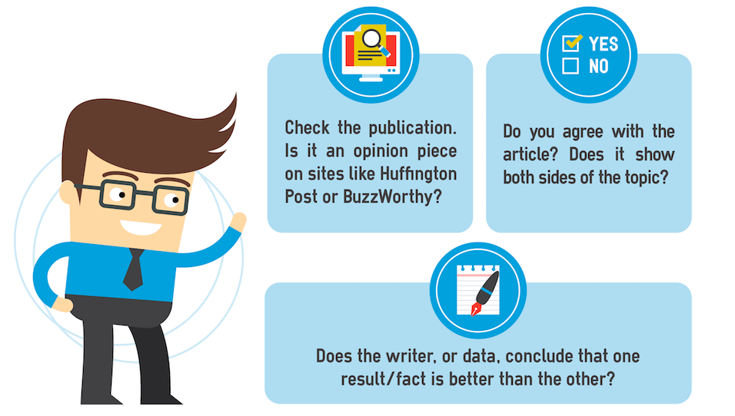
Objectivity: All scientific knowledge are objective as opposed to being subjective. This simply means that they are considered from the general perspective as opposed to being considered from the personal perspective. The purpose of a research work is usually to solve a problem or give explanation to a problem.

Slide 16
Ethical: Science does not exist on an island of it’s own, but exists within the framework of the human environment. Thus true and acceptable science must in some ways, put into consideration the values, morals, and ethical considerations of the society.

Slide 17
Systematic Exploration: Scientific research require verification and the only way a scientific research can be verified is where there is a systematic exploration which can be repeated. This means that a key feature of a scientific research is that it follows some particular steps and procedures and if these steps and procedures are repeated by any other person within a specific condition, the same result can be attained.

Slide 18
Reliable: It is a key feature of a research work qualified as scientific to be reliable. Reliable in this sense means that any other person may replicate similar results by following the systematic procedures laid down. If a research work cannot be relied upon by others and a similar result replicated, then it cannot be qualified as a scientific research.

Slide 19
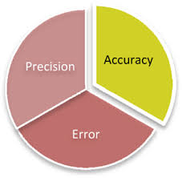
Accuracy: All scientific research works must have this all-important feature of being accurate. A research work usually lays down the goals at the beginning stage and the results aimed to achieve at the end. This end result must be attained a 100 percent. The precise nature of science increases the reliability of scientific research works.

Slide 20
Predictability: A good scientific research work should be predictable. This simply means that at the very early stages of the research work, a researcher should be able to predict the outcome. Due to the precise nature of science and scientific works, they are very easily predictable. Science does not allow for huge uncertainties and unknown variables. All unknown variables and uncertainties must therefore be eliminated so as to allow for a more predictable and reliable result.

Slide 21
Replicated: A scientific work will be of little to no relevance of it cannot be replicated following a systematic exploration/ procedure laid down by the originator. The possibility of replicating a particular research work and attaining a result which is exact with the original research is what makes for the general acceptability of scientific works. The fact that a research conducted in a lab in Europe can be replicated in Africa and a similar result attained qualifies such research as being scientific. If after the due procedures and steps are followed, a similar result cannot be attained, then the research work cannot be termed scientific.

Slide 22
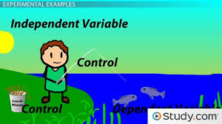
Controlled: All scientific research works are usually examined under a controlled environment. This allows for specific variables to be known as the knowledge of these variables allow for ease of repeating the said research work. All of the controlled variables must be made known so that a person who wishes to carry on the research can do so and attain a very similar result.

Slide 23
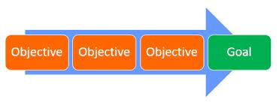
Objective/ Goal: Lastly, all scientific research works have a specific objective or goal as the end result in the mind of the researcher. Research are not just carried out without any objective or goal in mind. A research work is usually carried out with the aim of solving some world problems or making some new innovations. Thus, all scientific research must have a goal as the end product. This goal serves as the driving force for such research work.

Slide 24
General approaches to research
Deduction | Induction | Abduction
Logic | In a deductive inference, when the premises are true, the conclusion must also be true | In an inductive inference, known premises are used to generate untested conclusions | In an abductive inference, known premises are used to generate testable conclusions
Generalizability | Generalizing from the general to the specific | Generalizing from the specific to the general | Generalising from the interactions between the specific and the general
Use of data | Data collection is used to evaluate propositions or hypotheses related to an existing theory | Data collection is used to explore a phenomenon, identify themes and patterns and create a conceptual framework | Data collection is used to explore a phenomenon, identify themes and patterns, locate these in a conceptual framework and test this through subsequent data collection and so forth
Theory | Theory falsification or verification | Theory generation and building | Theory generation or modification; incorporating existing theory where appropriate, to build new theory or modify existing theory

Slide 25
Deductive process in research approach

Slide 26
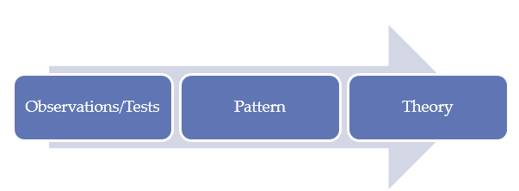
Inductive process in research approach

Slide 27
Abductive Approach
In abductive approach, the research process is devoted to explanation of ‘incomplete observations’, ‘surprising facts’ or ‘puzzles’ specified at the beginning of the study. Referring to the same research topic, you may observe that labour migration within the EU was actually decreasing the extent of cross-cultural differences within teams in Dutch private sector organizations.
In this case your study can be devoted to the explanation of this phenomenon by using qualitative and/or quantitative methods of data collection and data analysis in an integrated manner.

Slide 28
TASK TO DO:
Write about general approaches to a research with examples

Slide 29
REFERENCE LITERATURE:
https://research-methodology.net/research-methodology/research-approach/
2. Bryman A. & Bell, E. (2015) “Business Research Methods”4th edition, Oxford University Press, p.27
3. Source: Saunders, M., Lewis, P. & Thornhill, A. (2012) “Research Methods for Business Students” 6th edition, Pearson Education Limited

Slide 30
THANKS

